Slide 2
Overview of Sessions
Natural Entrepreneurs Phase | Session Title | PPT Start Slide Number
Intro (n/a) | Session 0: Introduction to Biomimicry | 3
DEFINE | Session 1: Visioning the Future | 21
DEFINE | Session 2: Select a Challenge | 29
DEFINE | Session 3: Understand your challenge | 39
DEFINE | Session 4: Writing a Research Question | 46
DISCOVER | Session 5: Exploring Nature for Solutions (pt.1) | 60
DISCOVER | Session 6: Exploring Nature for Solutions (pt.2) | 67
CREATE | Session 7: Create your Design Solution (pt. 1) | 96
CREATE | Session 8: Create your Design Solution (pt.2) | 99
CREATE | Session 9: Evaluating and Improving | 107
COMMUNICATE | Session 10: Communicating | 111

Slide 3
INTRODUCTION TO BIOMIMICRY
Phase 0

Slide 4
In this session you will…
Learn how biomimicry has helped solve human design challenges.
Become familiar with key terminology (function, strategy).
Practice key skills in biomimicry thinking.

Slide 5
Biomimicry Introduction
Choose a natural object.
Produce a brief sketch of this object.
Consider the function of your object:
- What does your object DO?
Label your sketch with as many functions as you can.
Consider the strategy:
- HOW does it do this?
Annotate each of your functions with a strategy.
For example, if someone had chosen twig from a tree, the function might have been ‘strength’ and the strategy could have been ‘moving and bending in the wind to absorb energy’.

Slide 6
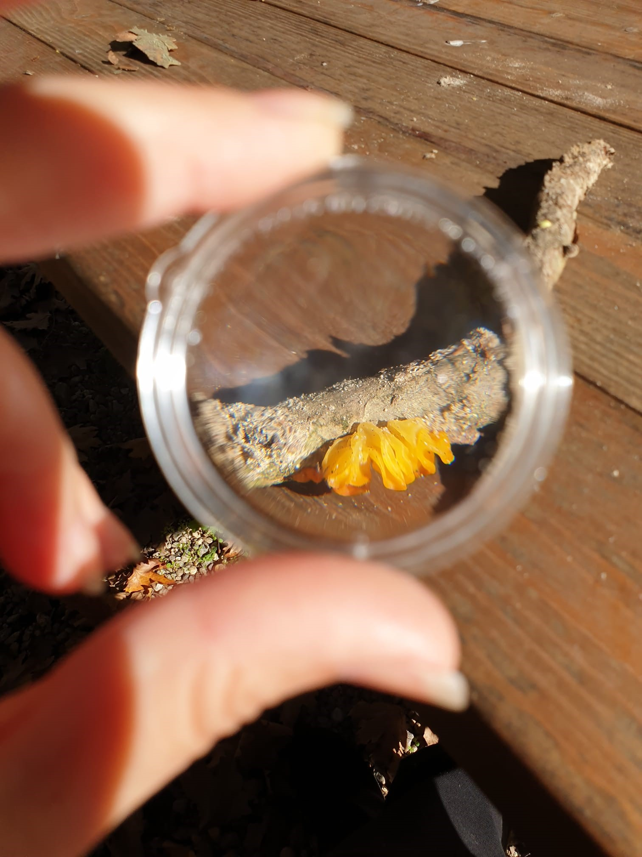
Biomimicry Introduction: Scavenger Hunt
It can be useful to search nature for specific functions and then to consider the strategy nature uses to achieve these functions.
Go on a scavenger hunt! Take a function card(s) and see how many examples of your function you can find in nature.

Slide 7
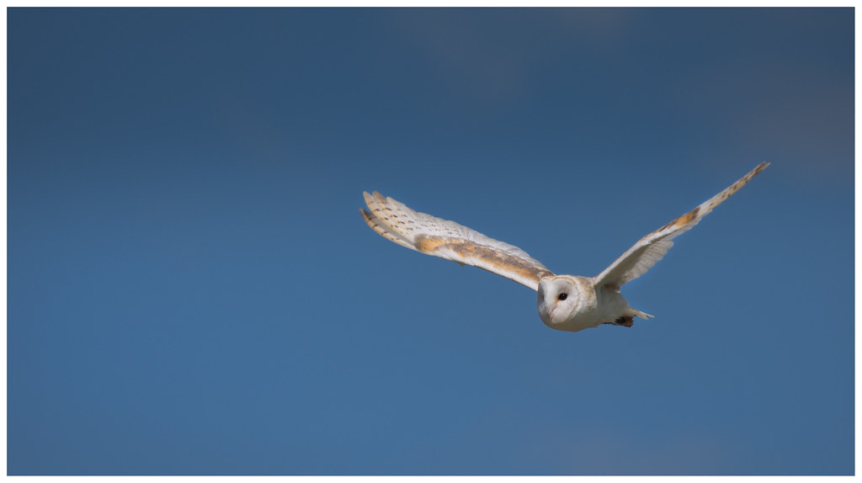
Biomimicry is an innovation method.
Notes:
Owl wings suppress noise. Evenly spaced bristles along the width of the wings break up sound waves as an owl flies, preventing them from building up and producing noise. At the same time, a canopy of downy feathers reduces air pressure on the wings’ surface, providing a dampening effect. Wind turbines can use the same thinking to reduce noise.
See: https://www.newscientist.com/article/dn27718-wind-turbines-with-owl-wings-could-silently-make-extra-energy/#ixzz5znJE68Ra
"Owl in flight" by SFB579 Namaste is licensed under CC BY 2.0

Slide 8
Learning from Nature
how to design a thriving and sustainable human-built world.
Notes:
"Owl in flight" by SFB579 Namaste is licensed under CC BY 2.0

Slide 9
Learning from Nature
how to design a thriving and sustainable human-built world.
The means.
Notes:
"Owl in flight" by SFB579 Namaste is licensed under CC BY 2.0

Slide 10
Learning from Nature
how to design a thriving and sustainable human-built world.
The means.
The end.
Notes:
"Owl in flight" by SFB579 Namaste is licensed under CC BY 2.0

Slide 11
Biomimicry:
A new science that studies nature’s models and then imitates or takes inspiration from these designs and processes to solve human problems.
Notes:
"Owl in flight" by SFB579 Namaste is licensed under CC BY 2.0

Slide 12
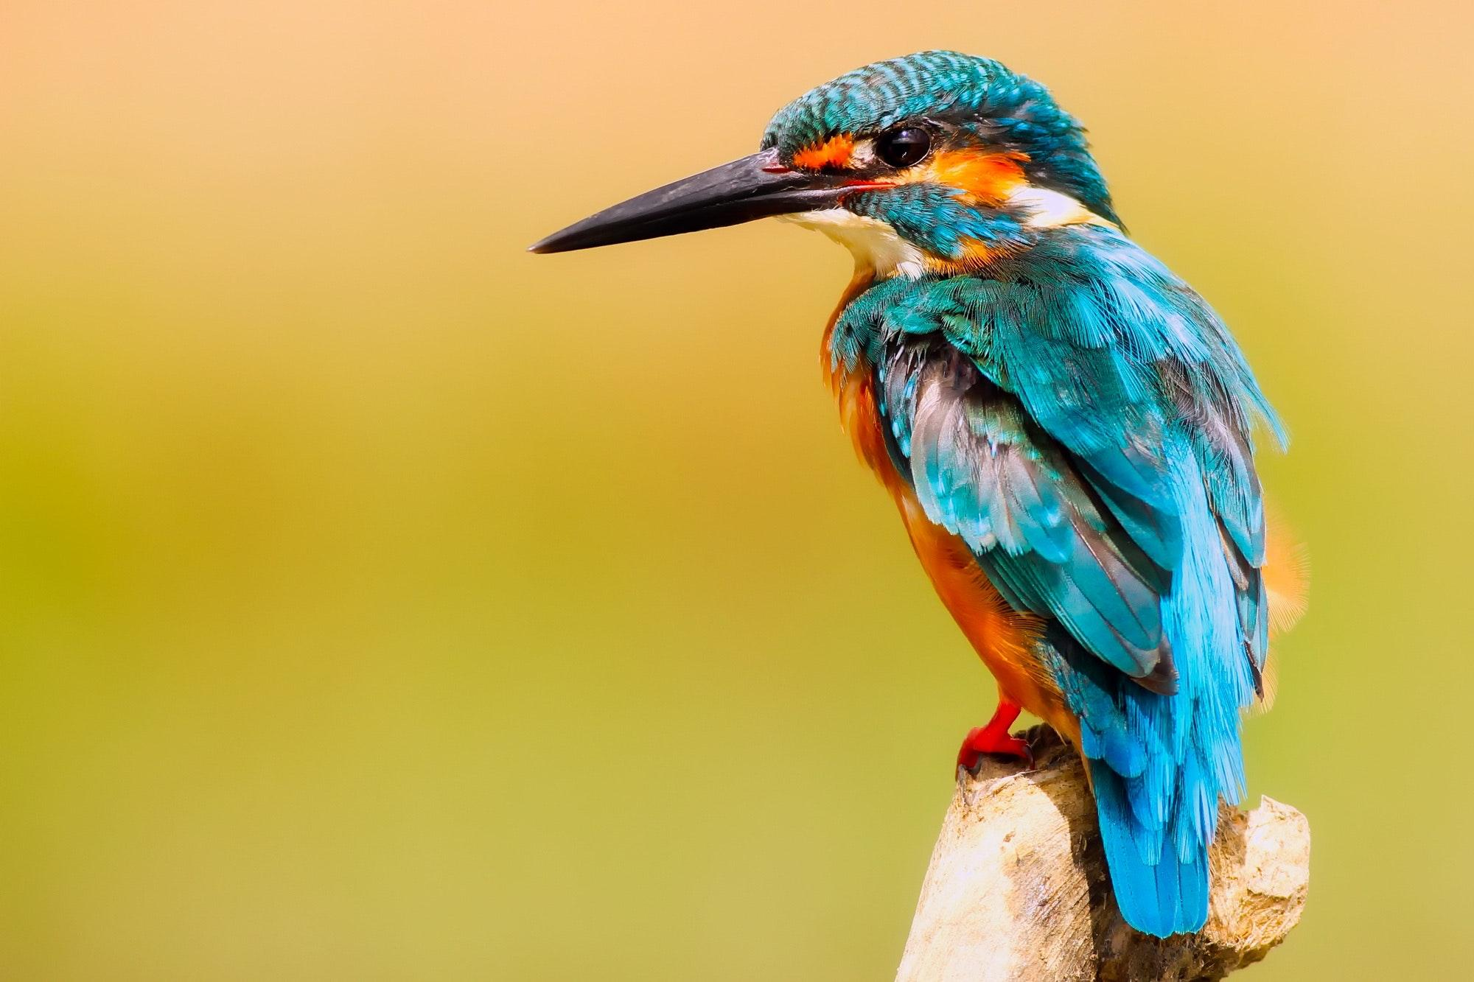
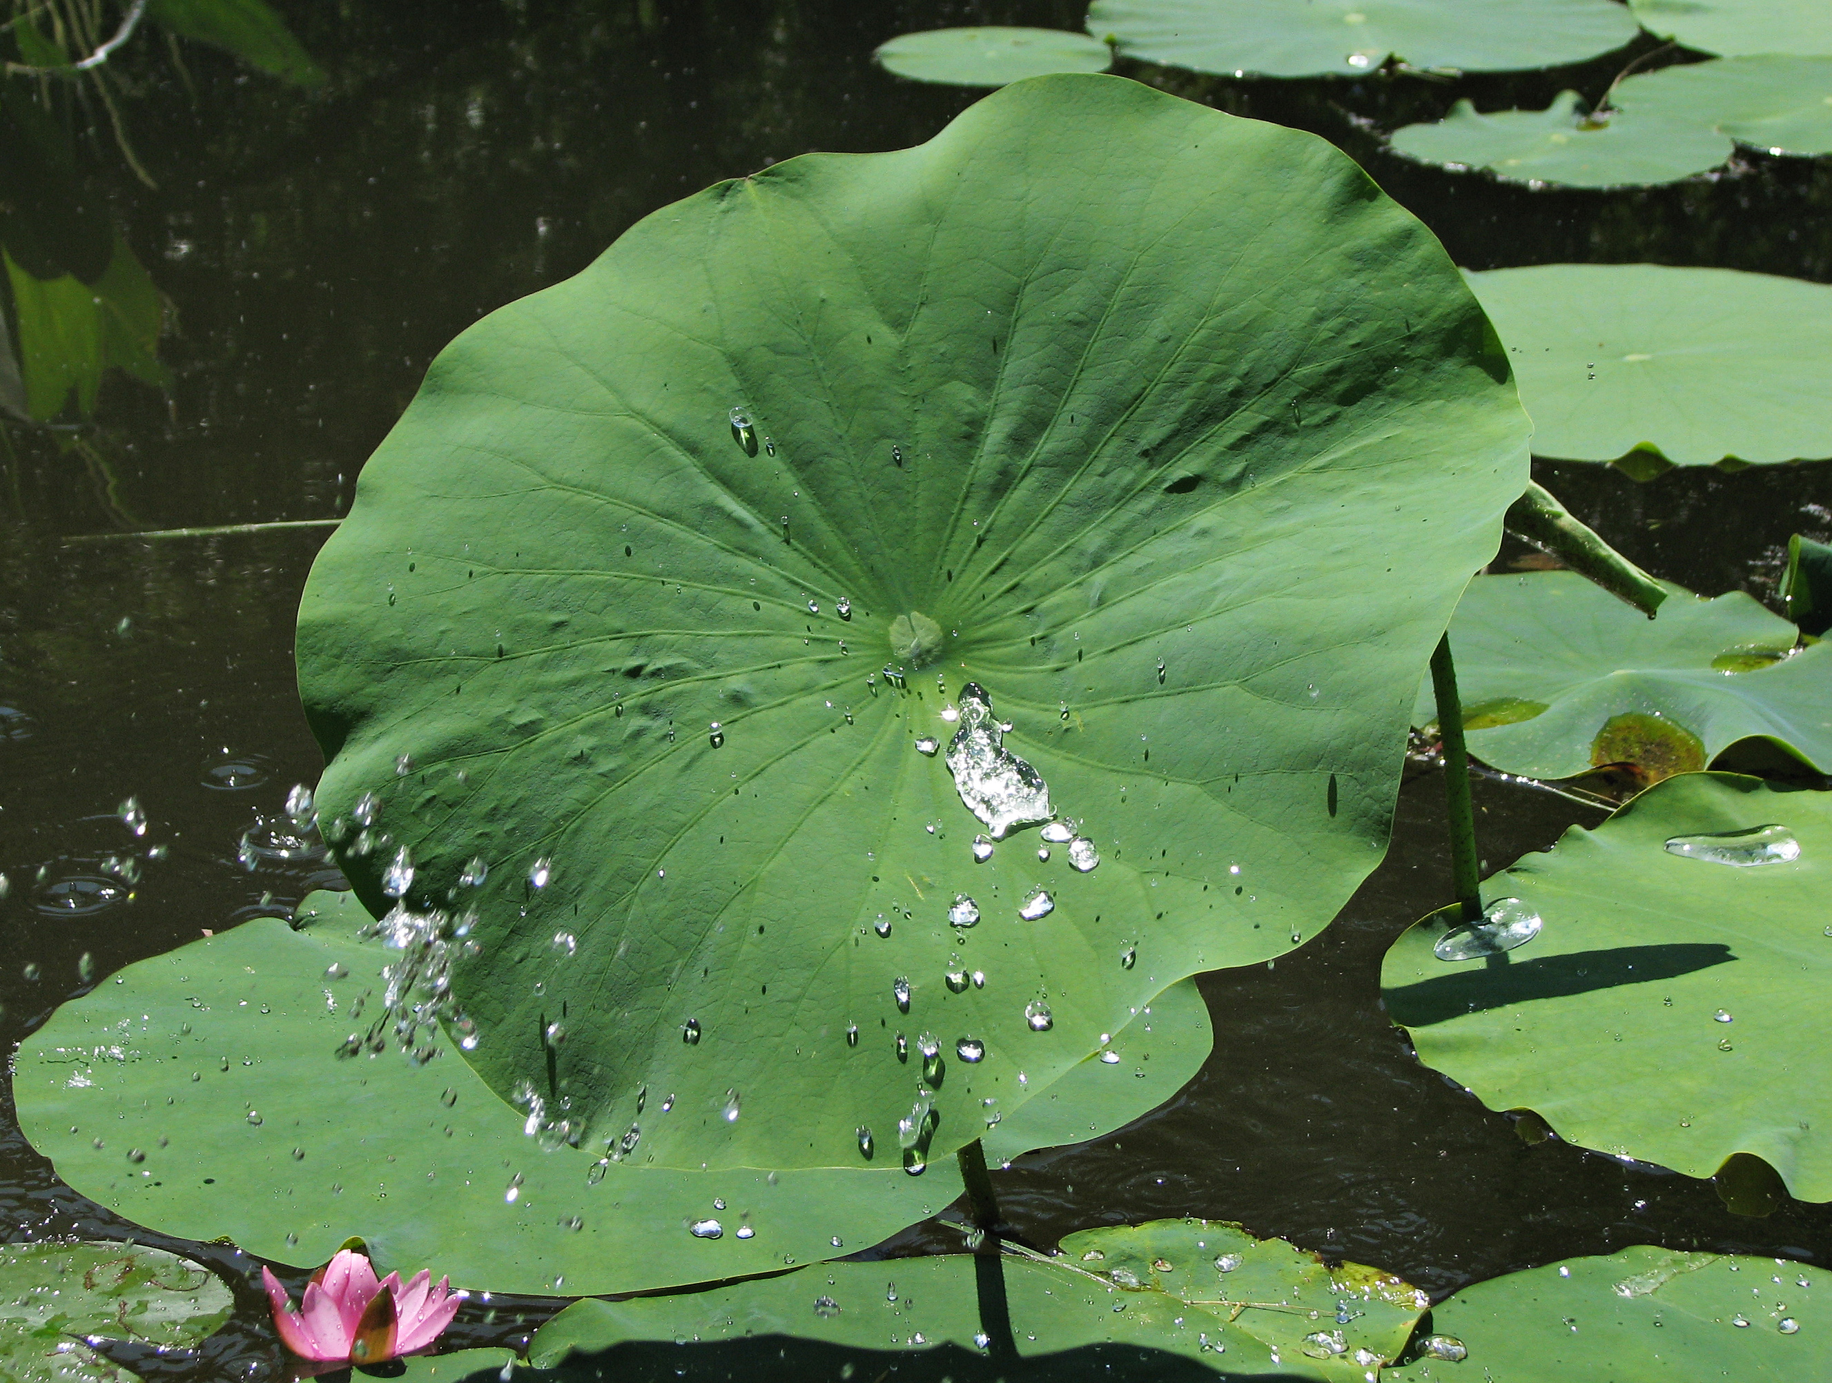
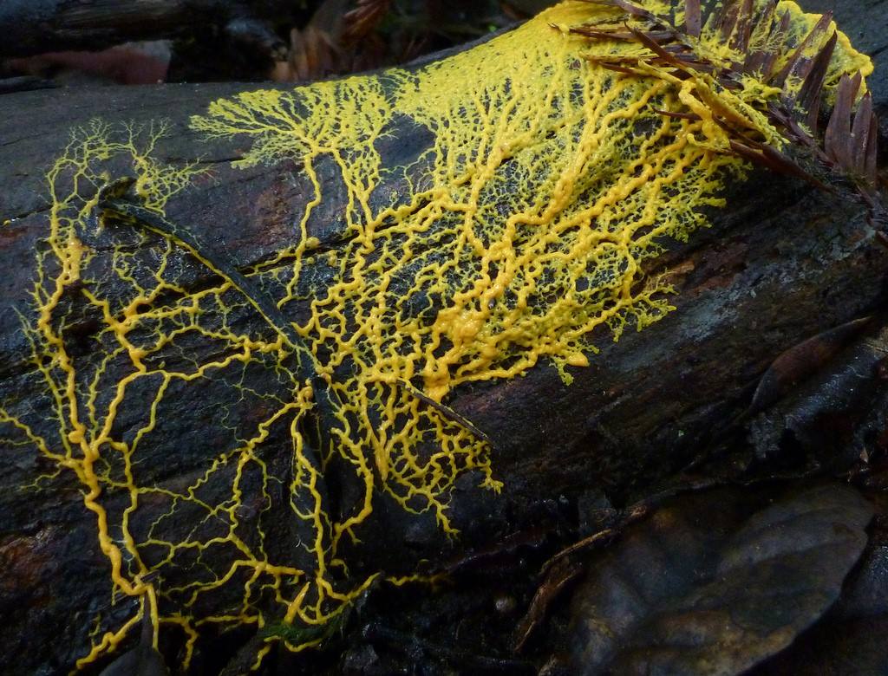
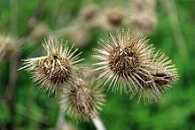
Can you guess what innovations each of these inspired?
Biomimicry Introduction: Quiz
1
2
3
4

Slide 14
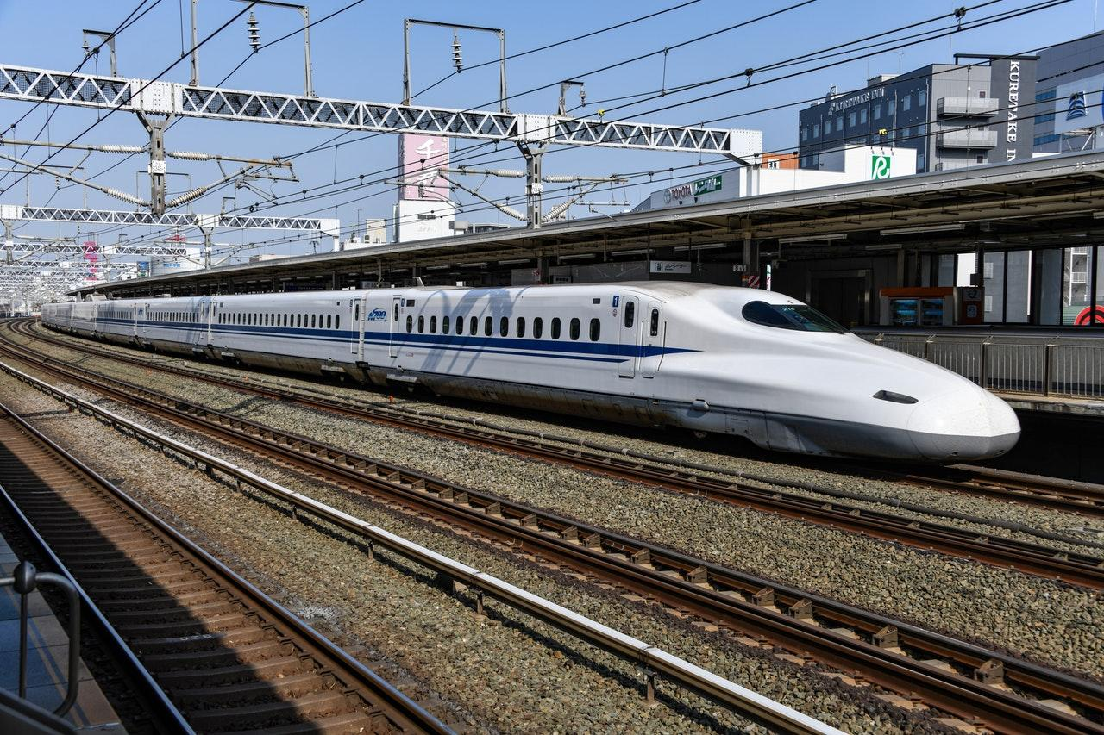
Challenge:
Bullet trains travel so fast they produce a loud boom when they exit tunnels caused by a cushion of air building up in front of the train. How does nature transition between different environments?
Nature’s strategy to meet the challenge:
The Kingfisher dives from the air (low drag) into rivers to catch fish, creating very little splash as it enters to water (high drag). It achieves this due to its streamlined beak which steadily increases from tip to head. Engineers mimicked this on the train and found it not only removed the boom, but also saved 10-15% more energy by being aerodynamic.

Slide 15
Notes:
Lotus plants have a peculiar way of staying dirt-free and being highly water repellent. As an aquatic plant in a muddy habitat, this is an obvious advantage, as clean leaves means more photosynthesis. The leaves’ microscopic structure holds the answer to their superhydrophobic properties.
Zoomed in on the leaf, we can see wax crystals and folds in the surface protruding from the surface, like tiny pyramids or traffic cones pointing upwards. Droplets of water are thus only supported by the tips, with plenty of air in between the tips. The lack of contact surface means the droplets don’t stick very well. It takes only a light breeze to make them dance and roll off the leaf, taking dirt particles with them.
The microscopic structure of lotus leaves has inspired self-cleaning paints, glass, textiles and more.

Slide 16
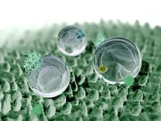
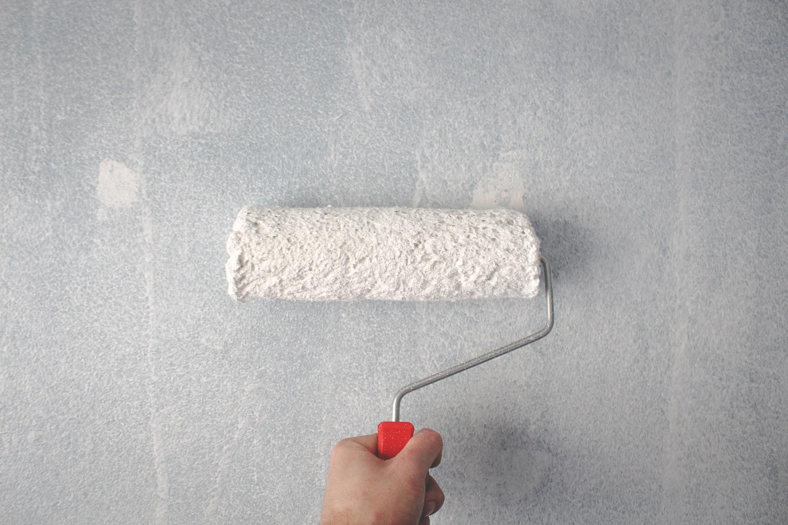
Challenge:
Newly painted buildings quickly get dirty, requiring time and effort to clean them. How does nature keep surfaces clean? How could we learn from this?
This Photo by Unknown Author is licensed under CC BY-SA
This Photo by Unknown Author is licensed under CC BY-SA
Nature’s strategy to meet the challenge:
Lotus leaves stay clean without detergents. The plant’s cuticle is extremely water repellent. This is accomplished through microscopic bumps on their leaf surface. This reduces the stickiness of water droplets to the surface so they run off easily and take dirt away at the same time.
This is being mimicked in self cleaning paints and glass.
Notes:
Lotus plants have a peculiar way of staying dirt-free and being highly water repellent. As an aquatic plant in a muddy habitat, this is an obvious advantage, as clean leaves means more photosynthesis. The leaves’ microscopic structure holds the answer to their superhydrophobic properties.
Zoomed in on the leaf, we can see wax crystals and folds in the surface protruding from the surface, like tiny pyramids or traffic cones pointing upwards. Droplets of water are thus only supported by the tips, with plenty of air in between the tips. The lack of contact surface means the droplets don’t stick very well. It takes only a light breeze to make them dance and roll off the leaf, taking dirt particles with them.
The microscopic structure of lotus leaves has inspired self-cleaning paints, glass, textiles and more.

Slide 17
Notes:
When presented with oat flakes arranged in the pattern of Japanese cities around Tokyo, brainless, single-celled slime moulds construct networks of nutrient-channeling tubes that are strikingly similar to the layout of the Japanese rail system, researchers from Japan and England report Jan. 22 in Science. A new model based on the simple rules of the slime mould's behaviour may lead to the design of more efficient, adaptable networks, the team contends.
https://www.theguardian.com/cities/2014/feb/18/slime-mould-rail-road-transport-routes
https://www.youtube.com/watch?v=uifP0FFmDyo
https://www.youtube.com/watch?v=b--9igdjVj0

Slide 18
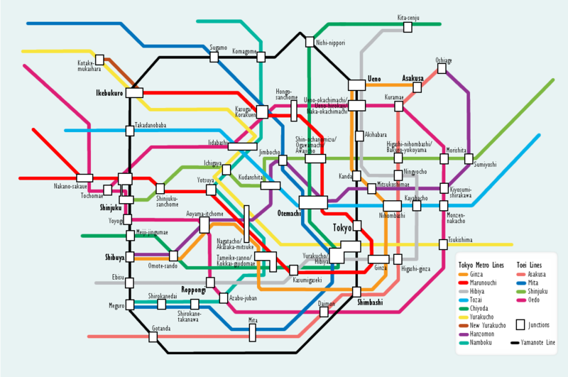
This Photo by Unknown Author is licensed under CC BY-SA
This Photo by Unknown Author is licensed under CC BY-SA-NC
Challenge:
Working out the most efficient* way to connect a large number of different points requires huge computing power. What is nature’s elegant solution?
(*achieving maximum productivity with minimum wasted effort or expense)
Nature’s strategy to meet the challenge:
Slime mould grows in patterns which efficiently find the quickest route to food sources.
Using oat seeds to represent neighborhoods in Tokyo, scientists observed how over a number of days the slime mould created a network of connecting “nutrient-tunnels” which closely replicated the Tokyo rail system.
Notes:
When presented with oat flakes arranged in the pattern of Japanese cities around Tokyo, brainless, single-celled slime moulds construct networks of nutrient-channeling tubes that are strikingly similar to the layout of the Japanese rail system, researchers from Japan and England report Jan. 22 in Science. A new model based on the simple rules of the slime mould's behaviour may lead to the design of more efficient, adaptable networks, the team contends.
https://www.theguardian.com/cities/2014/feb/18/slime-mould-rail-road-transport-routes
https://www.youtube.com/watch?v=uifP0FFmDyo
https://www.youtube.com/watch?v=b--9igdjVj0

Slide 19
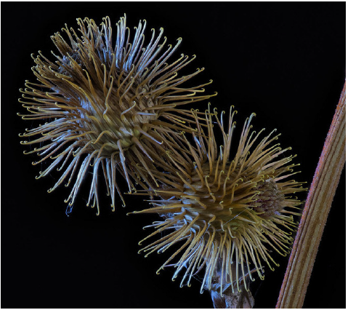
Notes:
In 1941 a Swiss engineer named George de Mestral was hunting in the Jura mountains in Switzerland when he noticed small burrs from what was later identified as the Burdock plant stuck to his pant legs and covering his dog’s fur.
He and his dog had been traversing riverbanks where Burdock typically grows wild (it does well in disturbed habitats where it can self-seed, and propagates its seeds through burrs that get stuck and distributed by the fur of passing animals). De Mestral wondered how the tiny hooks of the cockle-burs (the seed packets produced by Burdock, which are covered with stiff spines) were sticking to him.
He took the specimen home and examined the tiny hooks at the ends of the burr’s projections under a microscope, and he observed an interlocking mechanism that inspired him to consider: could a series of small-scale, interlocking hooks have a practical application in attire?
The burrs, after all, had clung to de Mestral’s pant leg in a manner that seemed to defy gravity– and they persisted even after his dog rolled around in the grass. De Mestral was inspired to model the configuration for use in clothing.
https://www.brainpickings.org/2011/05/13/happy-birthday-velcro/

Slide 20
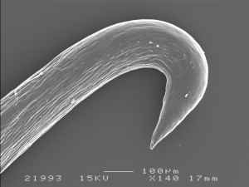
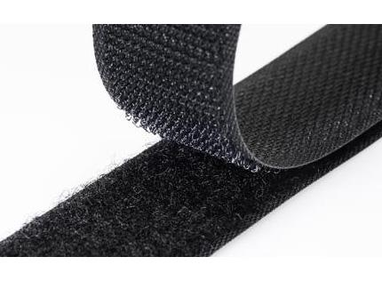
Challenge:
How could we connect two things quickly and easily, yet in a way that they could also be taken apart just as quickly? How would nature attach things together?
Nature’s strategy to meet the challenge:
The Burdock seed has tiny hook-tipped burrs. As an animal brushes past the Burdock, the hooks connect with the animal’s fur and the seed detaches; it is thus carried to a new location where it can grow.
Observing this inspired the creation of Velcro which is commonly used in clothing, tents and work equipment where two pieces are material need to be regularly sealed and unsealed quickly.
This Photo by Unknown Author is licensed under CC BY-SA
This Photo by Unknown Author is licensed under CC BY-SA-NC
Notes:
In 1941 a Swiss engineer named George de Mestral was hunting in the Jura mountains in Switzerland when he noticed small burrs from what was later identified as the Burdock plant stuck to his pant legs and covering his dog’s fur.
He and his dog had been traversing riverbanks where Burdock typically grows wild (it does well in disturbed habitats where it can self-seed, and propagates its seeds through burrs that get stuck and distributed by the fur of passing animals). De Mestral wondered how the tiny hooks of the cockle-burs (the seed packets produced by Burdock, which are covered with stiff spines) were sticking to him.
He took the specimen home and examined the tiny hooks at the ends of the burr’s projections under a microscope, and he observed an interlocking mechanism that inspired him to consider: could a series of small-scale, interlocking hooks have a practical application in attire?
The burrs, after all, had clung to de Mestral’s pant leg in a manner that seemed to defy gravity– and they persisted even after his dog rolled around in the grass. De Mestral was inspired to model the configuration for use in clothing.
https://www.brainpickings.org/2011/05/13/happy-birthday-velcro/

Slide 21
Session 1
DEFINE PHASE
Visioning the Future

Slide 22
In this session you will…
Get an overview of your biomimicry challenge.
Think about your local area and what might change in the future.
Learn about the SDGs (Sustainable Development Goals).
Form Teams ready to enter onto the NatEnt Platform.

Slide 23
Biomimicry Challenge
So what is your project going to be?
1. You are going to be working in Teams.
2. Your Team will…
Select a challenge related to the Sustainable Development Goals.
Identify the functions and strategies you might need to solve your Challenge.
Research nature to find ways that nature already uses to try and solve your Challenge.
Plan a solutions for your Challenge.
Evaluate your solution and how to improve it.
Sell your idea to others.

Slide 24
Visioning the Future…
10 minutes
In your Team you’re going to be visionaries.
We’d like you to imagine living in 10 years time, in 2032.
Use the Visioning Sheet to consider what it might be like in 2032.
What will have changed?
What challenges might you and your town be facing?
Use the prompt questions to help you.

Slide 25
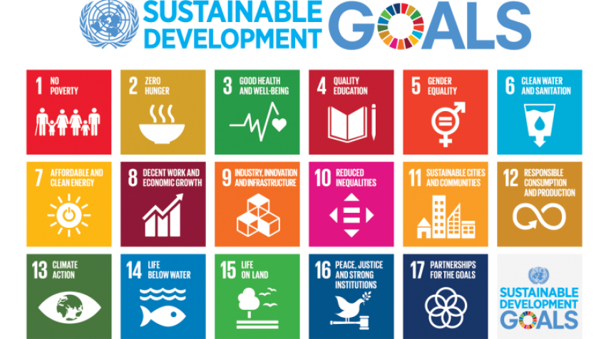
Sustainable Development Goals (SDGs)
A set of 17 internationally agreed goals to bring about a sustainable future, including:

Slide 27
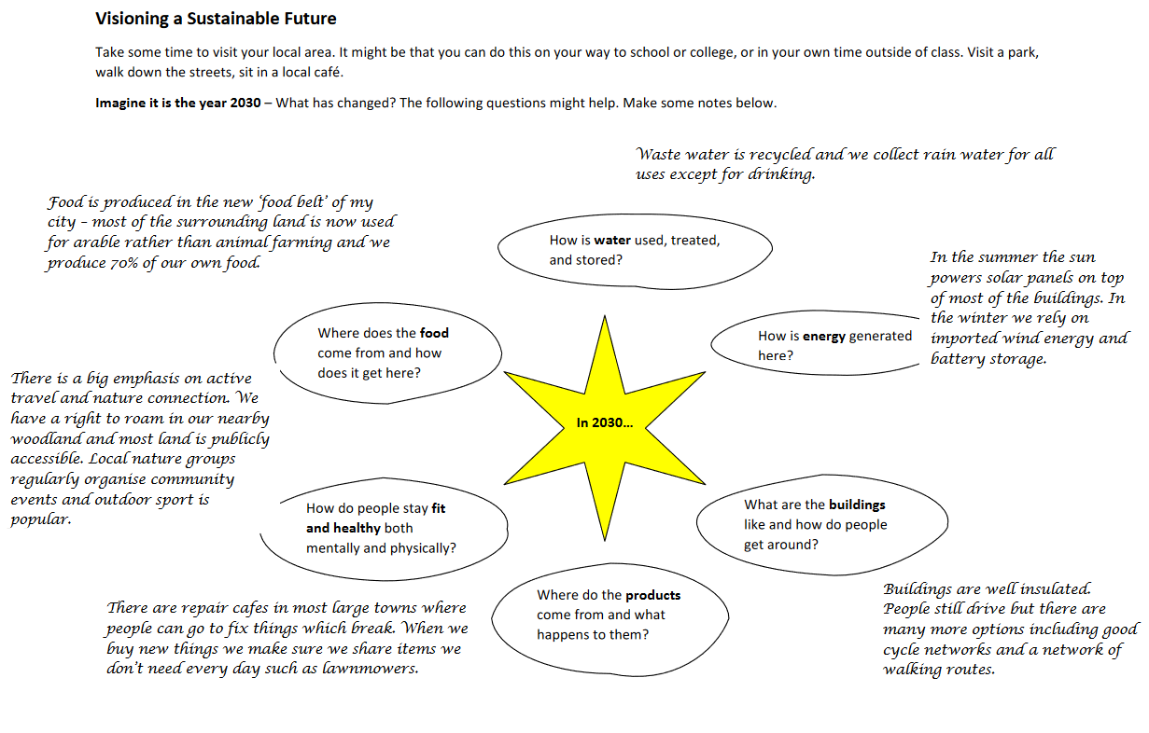
The SDGs and You
10 minutes
Look back at your Visioning Sheet.
Which SDGs might be most relevant to address the challenges you have identified?

Slide 28
Create Your Team
7 minutes
Last task:
Grab a Team Sheet from the front and complete it.
Team Name
Profile (not more than 40 words)

Slide 29
Session 2
DEFINE PHASE
Selecting Your Challenge

Slide 30
In this session you will…
Be introduced to the NatEnt Platform.
See what other Teams are up to.
Select a Challenge your Teams wants to work on.

Slide 31
Introducing the NatEnt Platform

Slide 32
Introducing the NatEnt Platform
Using the NatEnt Platform
Here are simple ground rules:
Be respectful and friendly to others – remember that nature rewards cooperation and so do we.
Don’t use anyone’s full name – respect their privacy and your own.

Slide 33
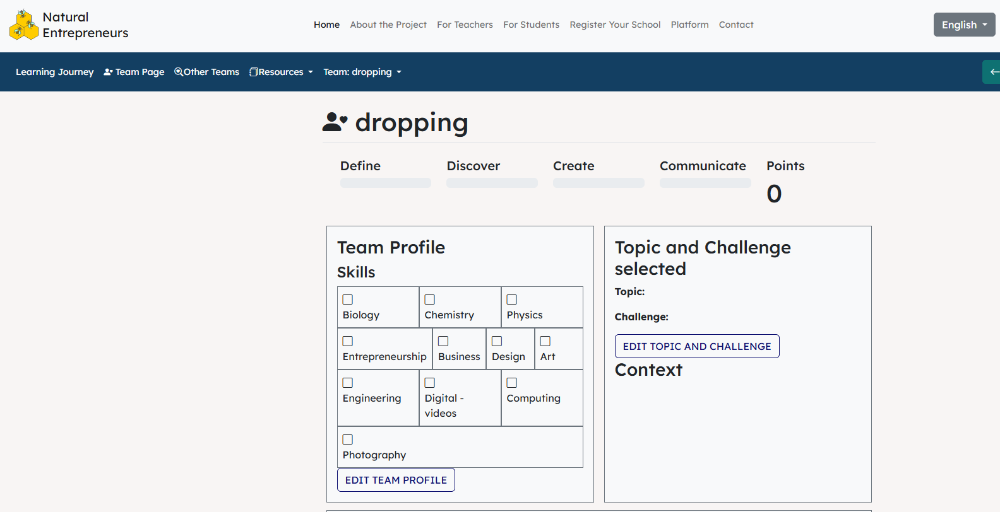
Introducing the NatEnt Platform
5 minutes
Log in to the Platform.
Visit Team Page and add the profile you wrote in the last lesson.

Slide 34
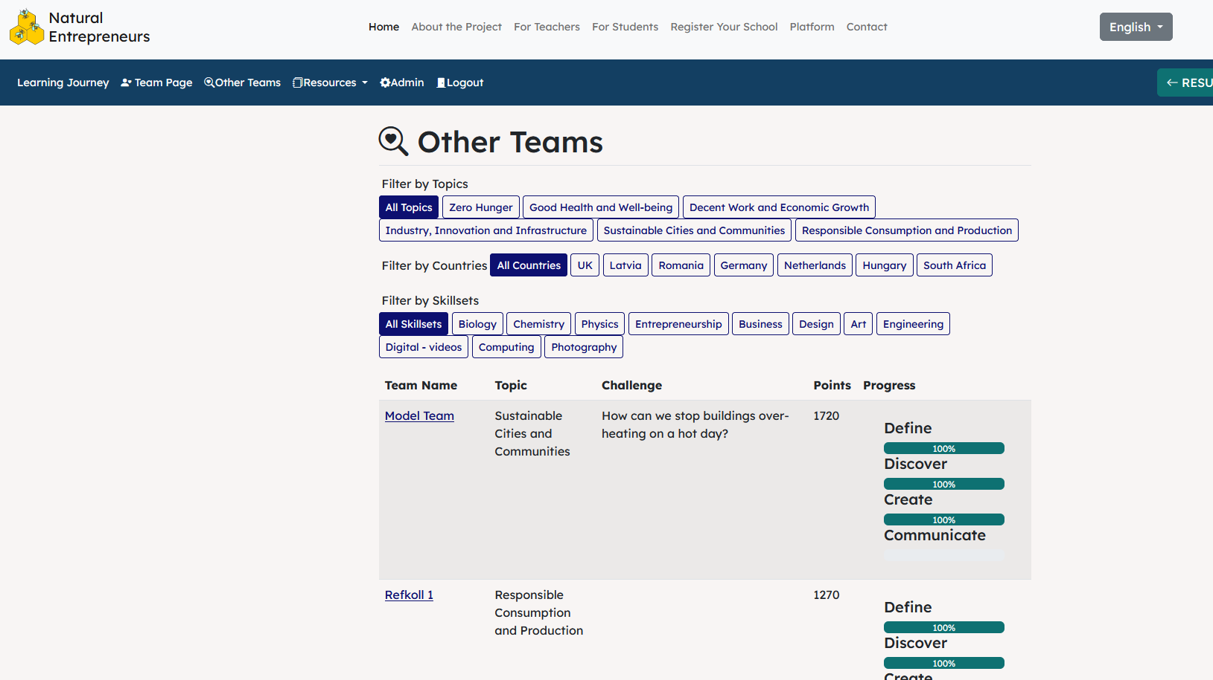
Introducing the NatEnt Platform
7 minutes
Visit the Model Team and read about the work this Team has done…you will be creating a similar profile for your Team.

Slide 35
Selecting a Challenge
10 minutes
Read through the Challenges and select one that your Team wishes to work on.
Click on each SDG icon to reveal different Challenges.
Read the Challenges.
Decide as a Team which Challenge you wish to address.

Slide 36
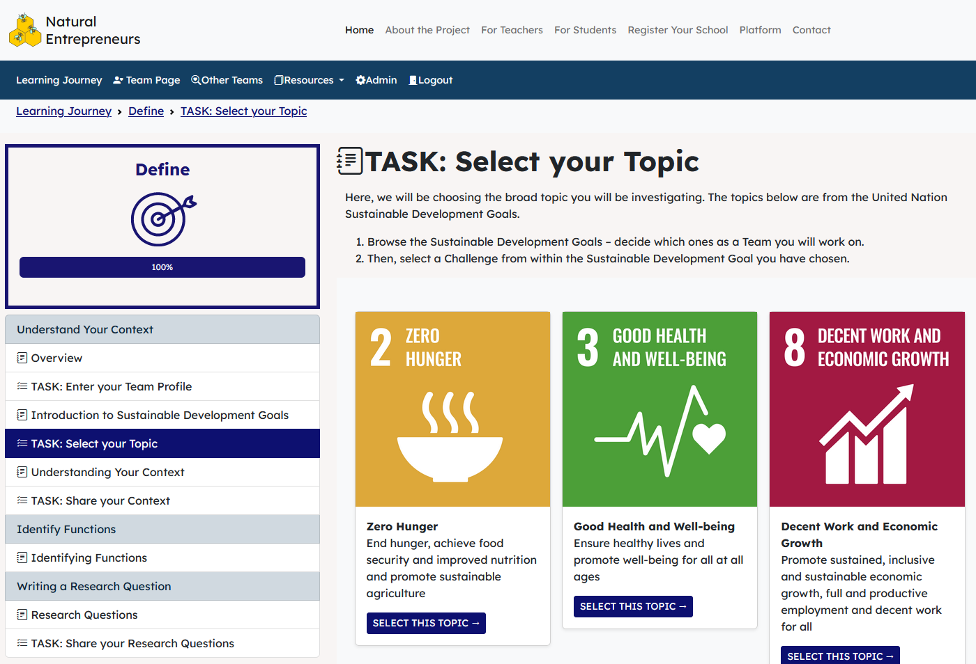
Select your Topic

Slide 37
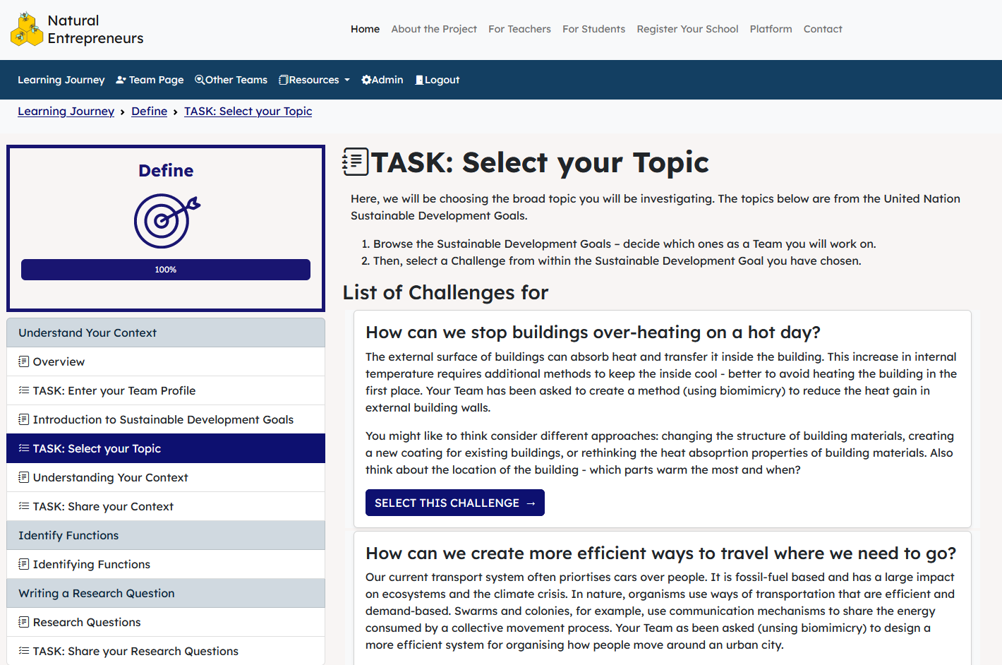
Select your Challenge
Read Challenges and
then select one

Slide 38
Understanding Your Challenge
10 minutes
It’s important to think about the situation in which your Challenge takes place. We call this context. Consider…
Who are you solving this Challenge for?
What will they gain from the solution? Are there any losers?
How might local conditions such as climate, weather, terrain and access affect my Design Solution?
How might the needs of local people affect how I approach this?
How might the solution affect local people, environment, and the economy?

Slide 39
Session 3
DEFINE PHASE
Understanding Your Challenge

Slide 40
In this session you will…
Explore your Challenge in more detail.
Understand the context surrounding your Challenge.
Consider the needs of people affected by your Challenge.
Enter the Context and Needs into the NatEnt Platform.

Slide 41
Understanding Your Challenge
20 minutes
It’s important to think about the situation in which your Challenge takes place. We call this context. Consider…
Who are you solving this Challenge for?
What will they gain from the solution? Are there any losers?
How might local conditions such as climate, weather, terrain and access affect my Design Solution?
How might the needs of local people affect how I approach this?
How might the solution affect local people, environment, and the economy?

Slide 42
Understanding Your Challenge
EXAMPLE: You are working on SDG 2 Zero Hunger, with the associated Challenge question of: “What if we grew all of our food in our towns and cities?” Thinking about the Context, a response might look something like this: Based in the South West of the UK, a significant limiting factor for being able to grow food all year round is the climate, so lots of food will have to be grown in protected and heated areas. Also, land is limited, and the majority of food will have to be plant based in 2030 with meat consumption dramatically reduced. When thinking about the limits of what is possible, there will be some food items which would require more resources to grow, so importing them may still be necessary, while focusing on what grows best in the local region. Impacts on the local area may include a change in the economy with more people working to grow food, and a significant change in the landscape with more arable rather than pasture land. Care will need to be taken not to let increased agricultural activity pollute local watercourses.

Slide 43
Understanding Your Challenge

Slide 44
IMPORTANT: What you write matters!
Use the Context & Needs worksheet to record your thinking.
When you have finished, enter your data onto the NatEnt Platform where other Teams can see and comment on it. Not just in the class, but other schools from across Europe.
You are able to read and comment on other Teams projects, as well as earn Team points.

Slide 45
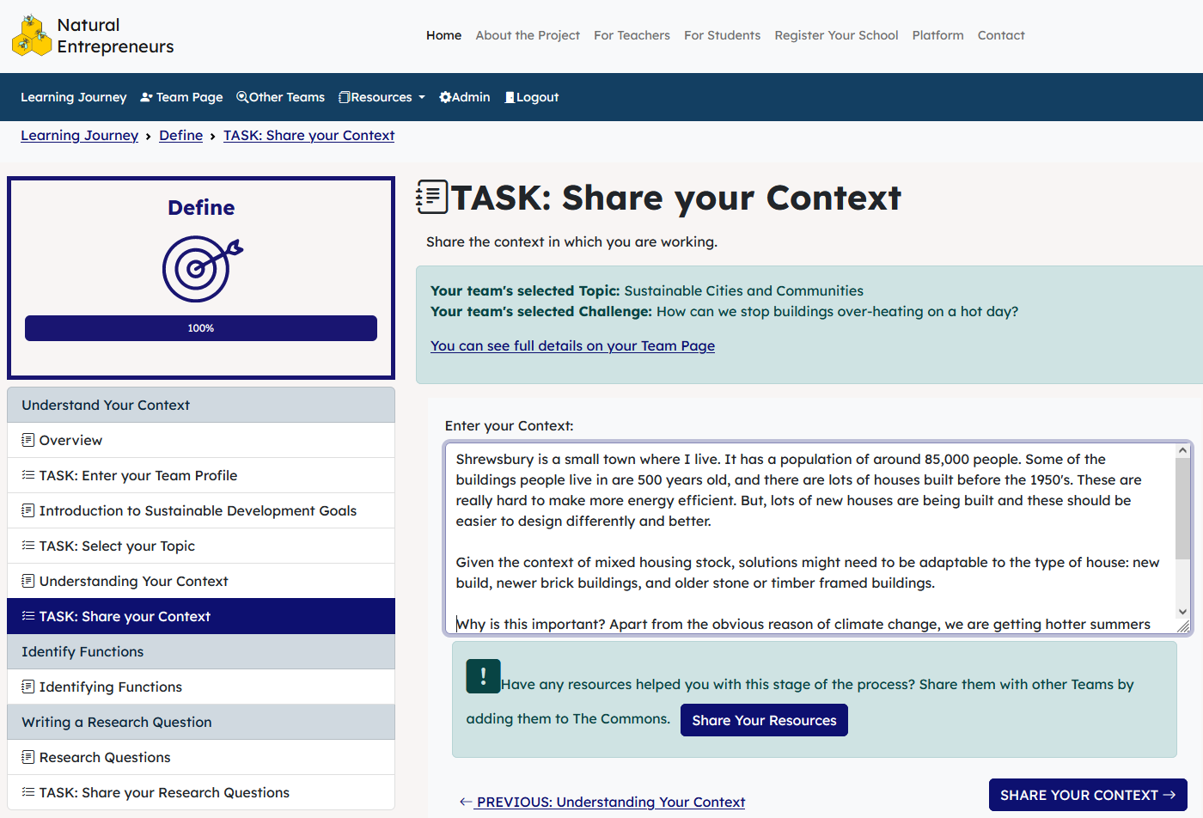
Share your context

Slide 46
Session 4
DEFINE PHASE
Writing Research Questions

Slide 47
In this session you will…
Think about what your Design Solution need to do to address your Challenge.
Write Research Questions your Team will use to find answers from nature.

Slide 48
What is a Function?
In biomimicry a function refers to an organism’s adaptations which help it survive.
For example, the purpose of bear fur is to keep warm, in technical terms its function is to conserve heat (insulation). A leaf is made to biodegrade, so one function of a leaf is to ‘break down’ after use. Human products also have functions; a kettle has the functions to both contain water and heat water (modify its physical state).
In brief, a function is ‘what it does.’

Slide 49
What is a Function?
The NatEnt Platform asks you to…
Identify the Functions your Design Solution will
need to do to solve your Challenge.
A good designer asks …
“What do you want your design to do?”
In other words … what Function(s) does it need to perform.

Slide 50
Why do we need to know about Functions?
Functions help us explore nature for solutions.
Functions provide a ‘bridge’ between human design and organisms in nature.

Slide 51
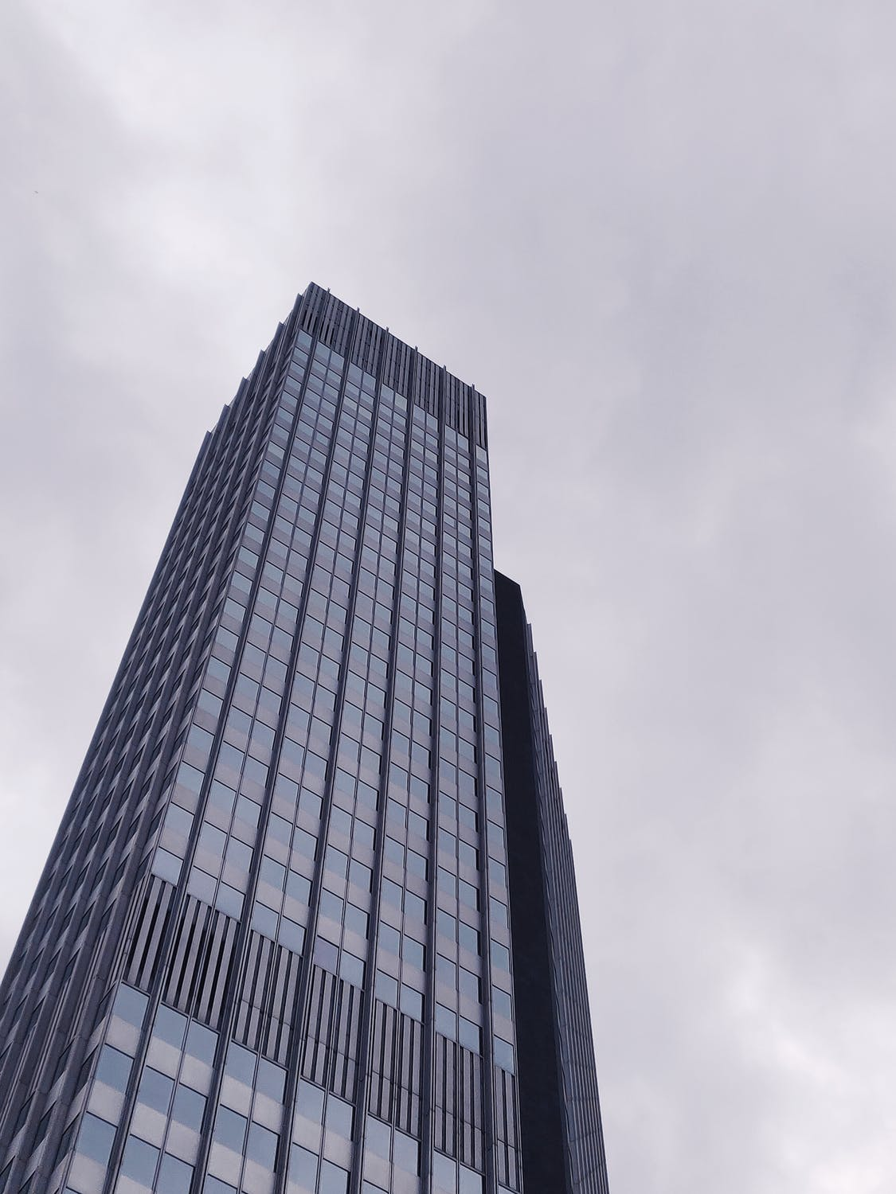
Why do we need to know about Functions?
I need to create a building to withstand strong winds. A key Function will be to provide strength.
Research organisms in nature which provide strength, especially in the context of strong winds.
Need to find a way to…
Provide strength
Search nature…
Possible solutions

Slide 52
How to write a good Function
A Function is always a verb.
Verb (action) = e.g. regulate temperature; maintain strength; filter liquids.
Ask yourself …
What do I want my design to do?
What is the organism I want to learn from doing?

Slide 53
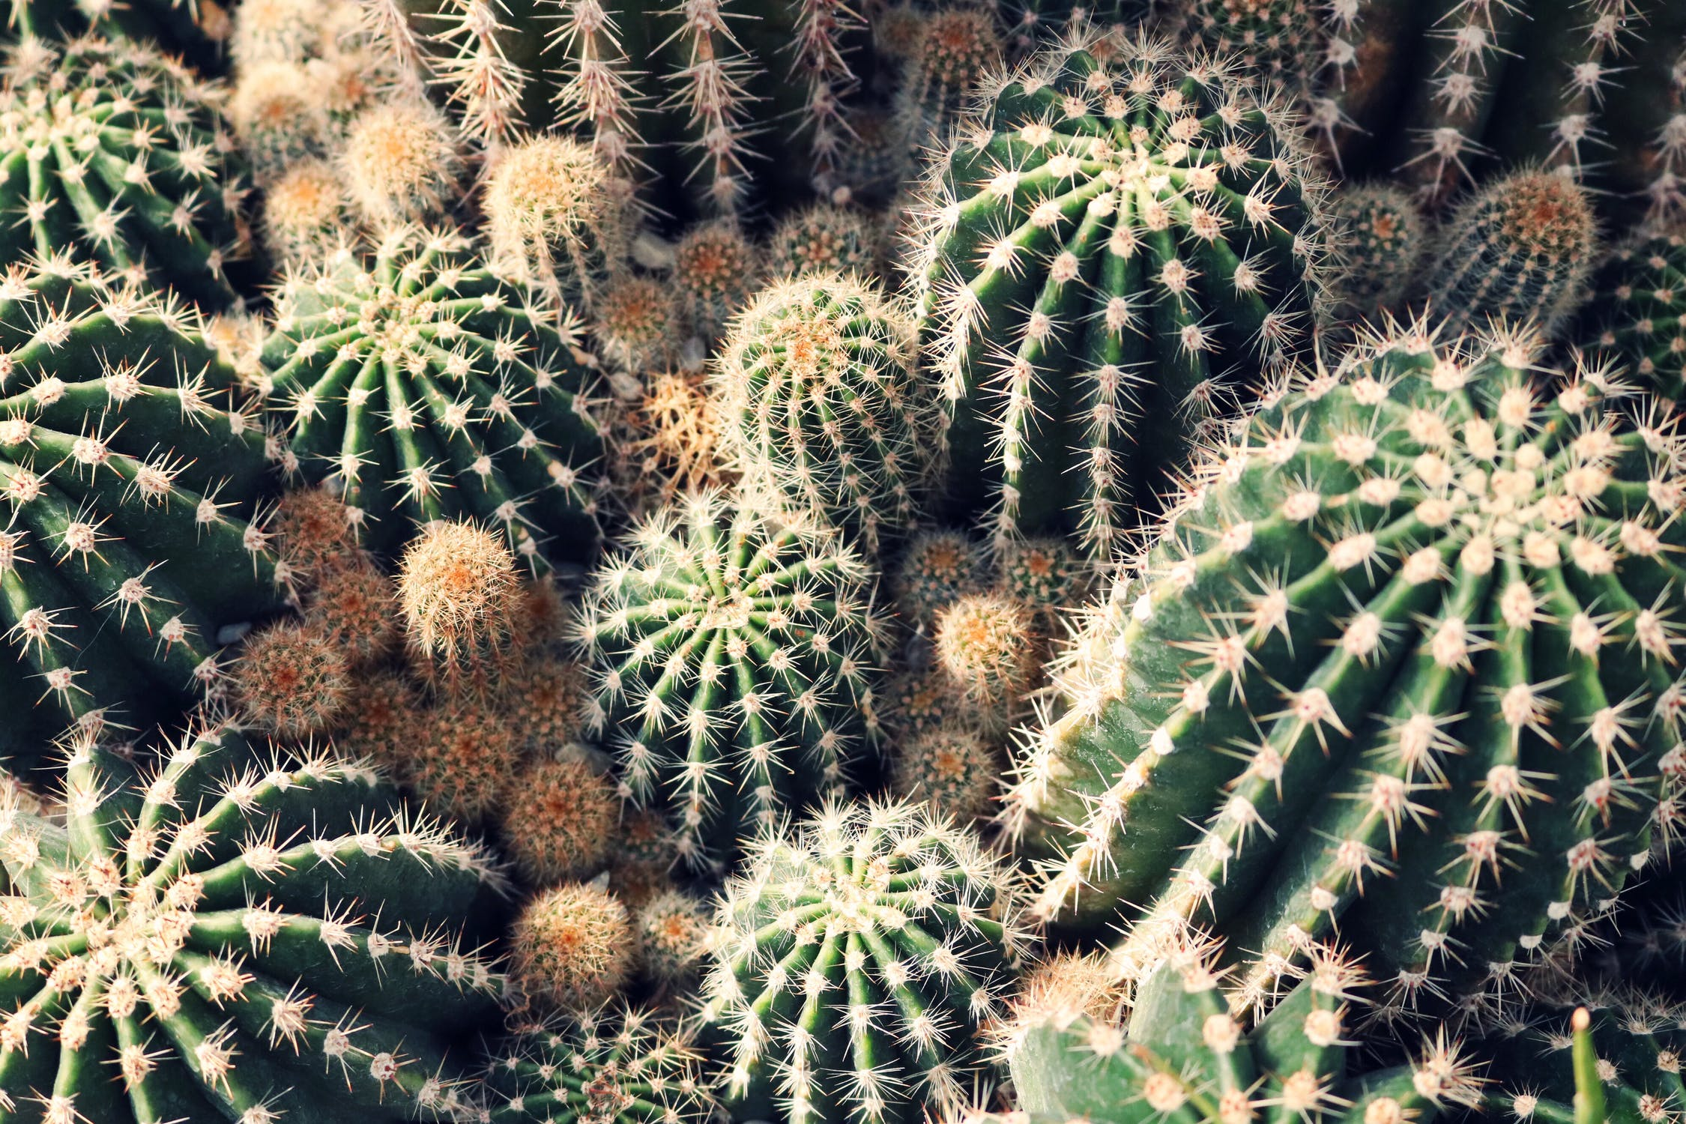
Functions are always written as verbs
Cactus (noun)
Shared function
Water bottle (noun)
Store liquids (verb)
Firefly (noun)
Lightbulb (noun)
Create light (verb)

Slide 54
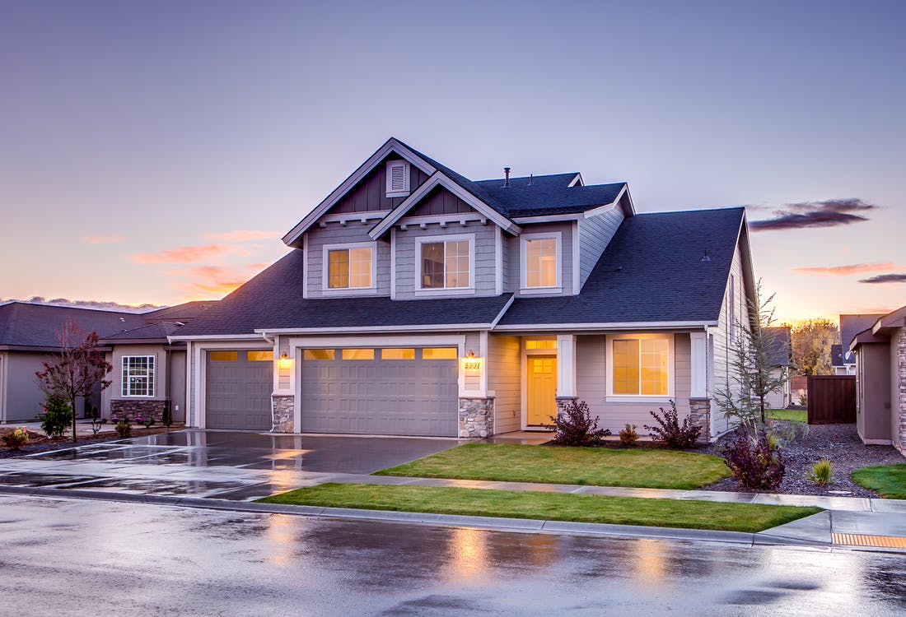
Activity (optional)
What does this house need to do?
Share ideas with your colleague and make a list.

Slide 55
Activity (optional)
You might have some of the following:
Protect from weather.
Generate energy.
Provide security.
Produce light.
Keep warm.
Keep cool.

Slide 56
What Functions does your Challenge need?
10 minutes
Read through the Functions Handout.
Highlight the Functions you think might be useful to solve your Challenge.

Slide 57
Writing Research Questions
10 minutes
We need to write Research Questions which nature can answer.
For example…
Perhaps are interested in designing a better bicycle helmet. If we asked:
How does nature built bicycle helmets?
We would have no response because nature does not do this. But what if we thought about the function required in a good helmet e.g. absorb impact.
How does nature absorb impact?
This is a question nature can help us answer e.g. observe woodpeckers hammering trees with their beak or male bison butting heads.

Slide 58
Writing Research Questions
10 minutes
To write your Research Questions…
STEP 1: take the Function you have already identified.
STEP 2: turn it into a question using the following…
How does nature…(store water)?
How does nature…(maintain temperature)?
Avoid questions which are too human focused such as:
How does nature build houses.
How does nature produce chemical free paint.

Slide 59
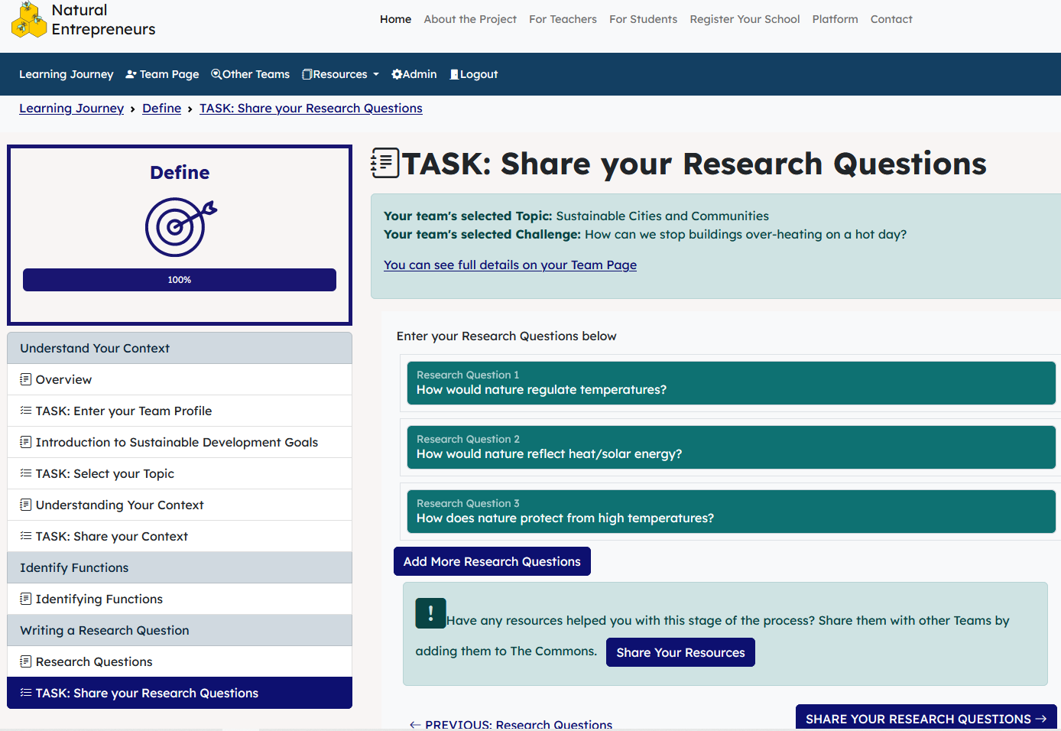
Add your data to the NatEnt platform
Add Research Questions here

Slide 60
Session 5
DISCOVER PHASE
Exploring Nature for Solutions

Slide 61
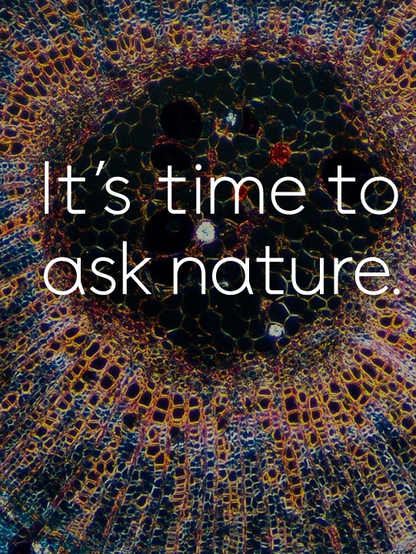
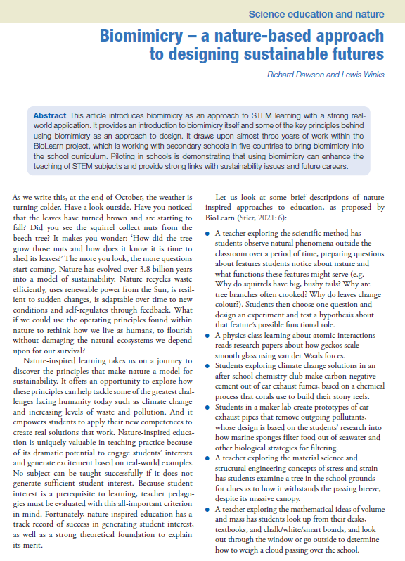
How can we Explore Nature?
You are going to carry out research to find answers to your Research Questions. To answer your Research Questions, you will need to explore nature to discover answers. There are three approaches:
Go outside…
AskNature.org
Scientific papers

Slide 62
Explore Nature – Go Outside
Task: look at your list of functions needed for your Challenge, and your Research Questions; explore your school grounds / local park for examples of these functions in nature. Use the question areas below to help you make detailed observations.
1. Describe its structure.
Observations about your organism
4. How does it move?
2. Look closely at the detail.
3. What is its job (function) in nature?
5. How can we use it to solve our challenge?

Slide 63
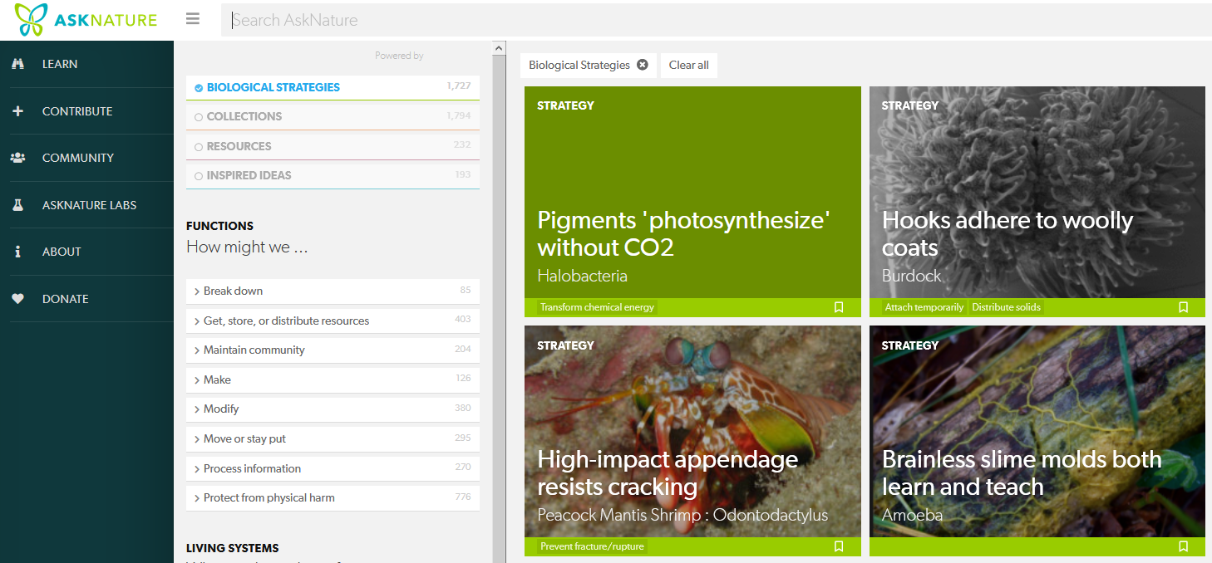
Explore Nature – www.asknature.org
Getting outside is an excellent way to explore nature. But there are some excellent online resources too. Use your Function to search.

Slide 64
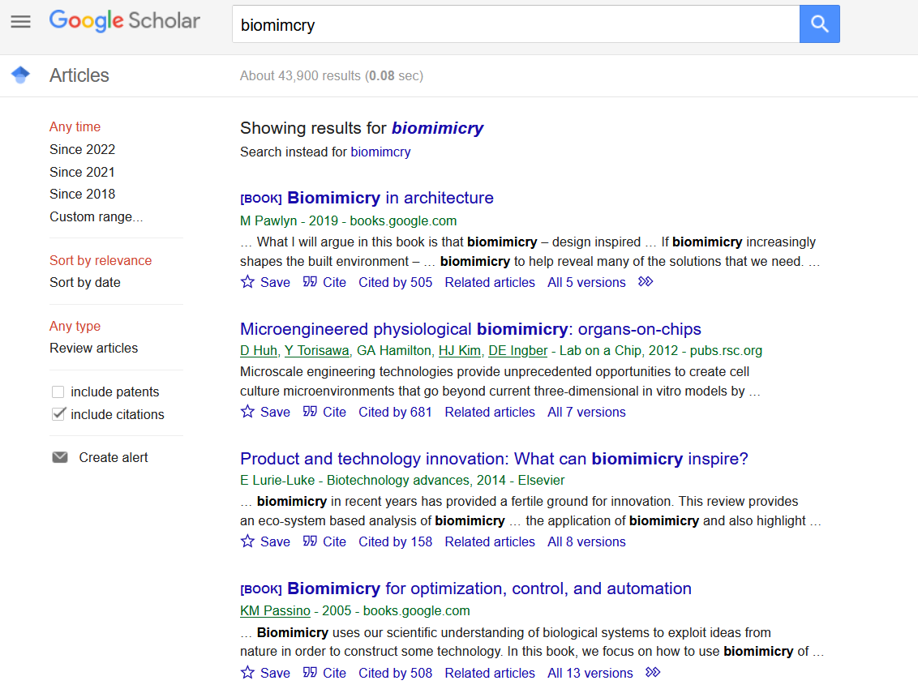
Explore Nature – Scientific Papers
Google Scholar is one resource for finding research papers related biomimicry.
Try searching for biomimicry + the function you are interested in.

Slide 65
How to Record your Research?
Record your research using the Species Report Cards.
Complete steps 1,2 and 3 for each organism you study.
Find at least two organisms for each Research Question.

Slide 66
How to Record your Research?
You will find other examples of completed cards in the Model Team on the NatEnt Platform.

Slide 67
Session 6
DISCOVER PHASE
Exploring Nature for Solutions – part 2

Slide 68
Abstracting Design Principles
You need to translate your research into Design Principles an engineer or designer can use to create a Design Solution.
This is called Abstracting.
The results are entered into box 4 on your Species Report Card.

Slide 69
How to Record your Research?

Slide 70
Abstracting Design Principles
In the following slides we will:
Provide you with examples of how to abstract.
Give you practice trying out this skill for yourself.

Slide 71
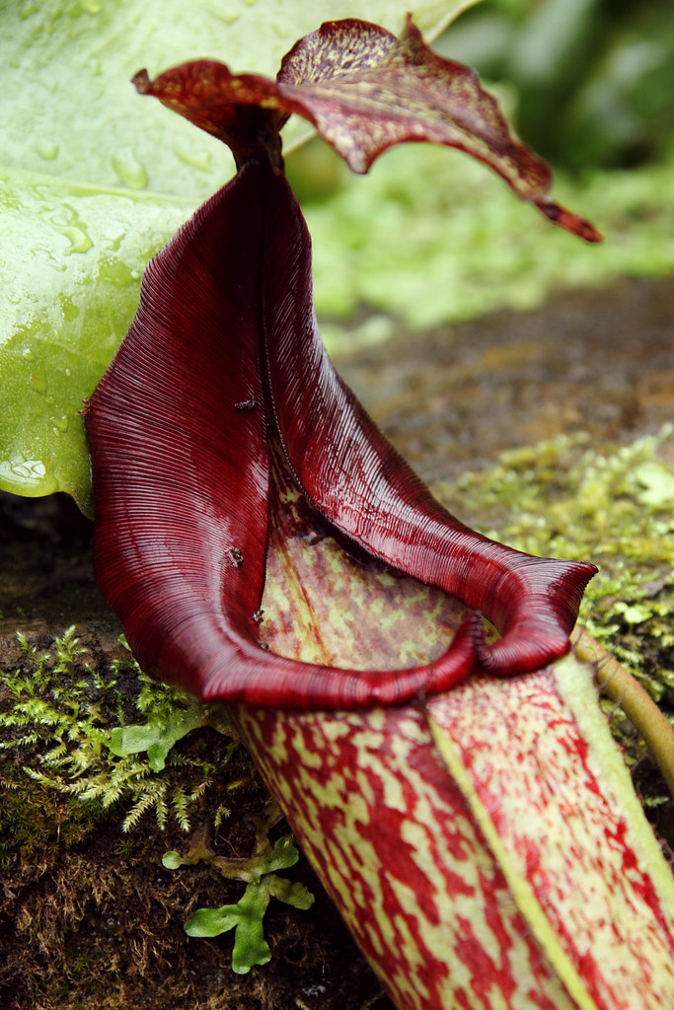
The Pitcher Plant - strategy
STEP 1 – describe the strategy in detail
The outer rim of the Pitcher plant is very slippery, increasing the likelihood of insects falling inside. The plant achieves this slippery surface in two ways. Firstly, a pattern of tiny ridges run into the plant. These are made from overlapping cells (like roof tiles) that give the surface directionality – making it easier to slide into the plant than to climb out. Secondly, water from rain or humidity reduces friction, making grip increasingly difficult.
"Pitcher Plant at Kew Gardens" by charlieishere@btinternet.com is licensed under CC BY 2.0

Slide 72
The Pitcher Plant - strategy
STEP 2 – identify key words and concepts that capture how the strategy delivers its function
The outer rim of the Pitcher plant is very slippery, increasing the likelihood of insects falling inside. The plant achieves this slippery surface in two ways. Firstly, a pattern of tiny ridges run into the plant. These are made from overlapping cells (like roof tiles) that give the surface directionality – making it easier to slide into the plant than to climb out. Secondly, water from rain or humidity reduces friction, making grip increasingly difficult.
"Pitcher Plant at Kew Gardens" by charlieishere@btinternet.com is licensed under CC BY 2.0

Slide 73
Design Principle
STEP 3 – write a statement that describes the strategy without using biological terms
Tiny aligned ridges create surface direction and reduce friction.

Slide 74
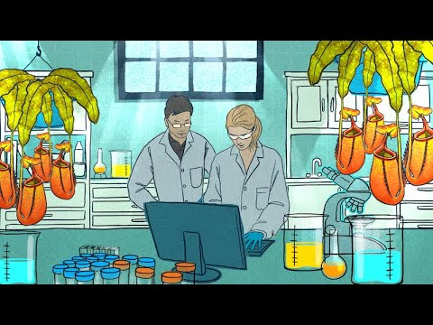
Want to learn more - watch the short video clip
Or move on to practice for yourself.

Slide 75
Your turn to try some examples
Namib Beetle

Slide 76
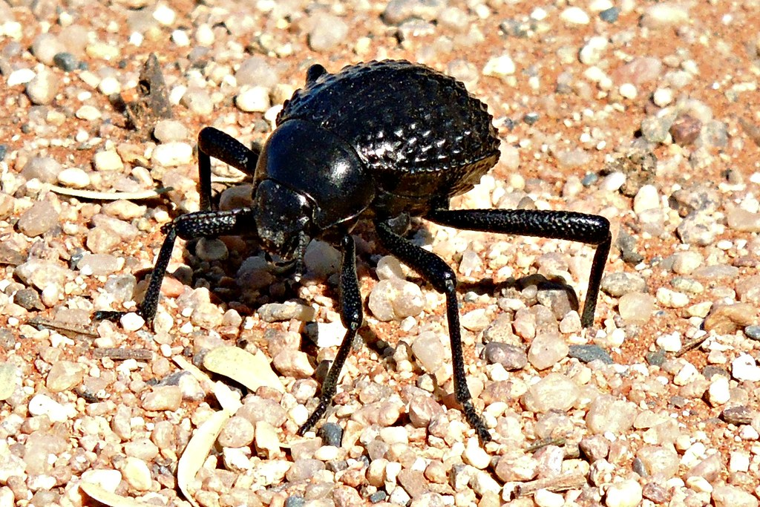
Here is the description of the strategy
used by the Namib Beetle to collect water.
TASK - note down key words and phrases which help understand how the strategy works
The Namib Beetle collects water droplets from morning fog. Its black shell is covered in bumps which are hydrophobic (water repelling). The passing fog condenses on them and quickly runs off into hydroscopic (water attracting) channels which guide the water to the mouth parts for drinking.
"Namibian Desert Beetle Stenocara gracilipes" by harryandrowenaphotos is licensed under CC BY-NC-ND 2.0

Slide 77
Which of the choices below do you think best identifies the key words?
The Namib Beetle collects water droplets from morning fog. Its black shell is covered in bumps which are hydrophilic (water attracting). The passing fog condenses on them and quickly runs off into hydrophobic (water repelling) channels which guide the water to the mouth parts for drinking.
The Namib Beetle collects water droplets from morning fog. Its black shell is covered in bumps which are hydrophilic (water attracting). The passing fog condenses on them and quickly runs off into hydrophobic (water repelling) channels which guide the water to the mouth parts for drinking.
Option 1
Option 2

Slide 78
If you chose option 1 then good job … correct
The Namib Beetle collects water droplets from morning fog. Its black shell is covered in bumps which are hydrophilic (water attracting). The passing fog condenses on them and quickly runs off into hydrophobic (water repelling) channels which guide the water to the mouth parts for drinking.
bumps
hydrophobic (water repelling) channels
hydrophilic (water attracting)
These are all non-biological terms which can be applied into different situations.

Slide 79
If you chose option B, not there yet…
These highlighted words are a description of the context and organism, and are less helpful when abstracting.
Morning fog - this is not about the strategy but the context where the Namib Beetle lives.
Shell is covered in bumps - the shell is specific to the beetle and probably not replicable in a design, but the shape of the bumps might be,
Channels - the principle of channelling water might be helpful, but the mouth parts are specific to the beetle.
The Namib Beetle collects water droplets from morning fog. Its black shell is covered in bumps which are hydrophilic (water attracting). The passing fog condenses on them and quickly runs off into hydrophobic (water repelling) channels which guide the water to the mouth parts for drinking.

Slide 80
You should have noted the following key words:
bumps
hydrophobic (water attracting)
hydroscopic (water repelling) channels
"Namibian Desert Beetle Stenocara gracilipes" by harryandrowenaphotos is licensed under CC BY-NC-ND 2.0
Now you need to combine your key words into a sentence describing the strategy in non-biological terms.

Slide 81
You might have written the following:
Create hydrophilic bumps to collect water surrounded by hydrophobic channels to direct water.
"Namibian Desert Beetle Stenocara gracilipes" by harryandrowenaphotos is licensed under CC BY-NC-ND 2.0

Slide 82
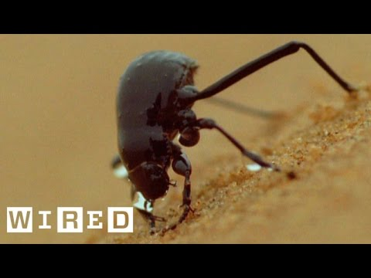
Want to learn more - watch this short video clip
And move on the practice another example.

Slide 83
Your turn to try some examples
2. Rainforest Ecosystems

Slide 84
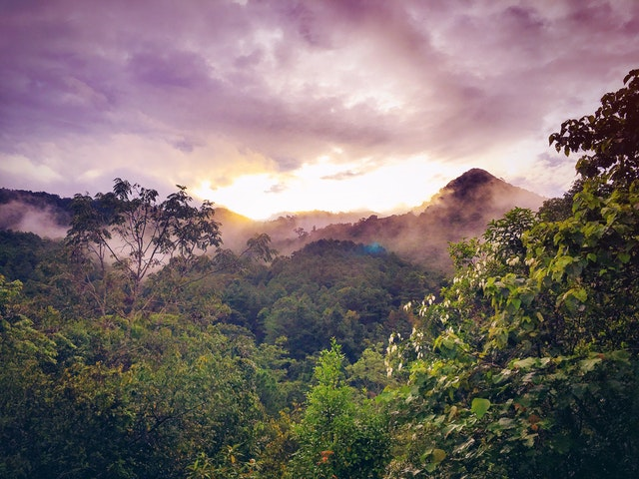
Here is the description of the strategy used by rainforest ecosystems to maintain symbiotic relationships.
STEP 1 - note down key words and phrases which help understand how the strategy works
In a rainforest ecosystem symbiotic relationships exist between different species. These symbiotic relationships benefit both partners, for example the pollination of plants in return for nectar (called mutualism relationships). Such relationships ensure both partners can flourish and benefit the wider ecosystem.

Slide 85
STEP 2 – highlight the key words you think are important in describing how a rainforest maintains symbiotic relationships
In a rainforest ecosystem symbiotic relationships exist between different species. These symbiotic relationships benefit both partners, for example the pollination of plants in return for nectar (called mutualism relationships). Such relationships ensure both partners can flourish and benefit the wider ecosystem.

Slide 86
Is you selection similar to below?
In a rainforest ecosystem symbiotic relationships exist between different species. These symbiotic relationships benefit both partners, for example the pollination of plants in return for nectar (called mutualism relationships). Such relationships ensure both partners can flourish and benefit the wider ecosystem.
Relationships benefit both partners
Both partners can flourish
Benefit the wider (ecosystem)
These are all non-biological terms which can be applied into different situations. But, you might need to replace the term ecosystem with something more appropriate to your design.

Slide 87
You should have noted the following key words:
Relationships benefit both partners
Both partners can flourish
Benefit the wider (ecosystem)
Now you need to combine your key words into a sentence describing the strategy in non-biological terms.

Slide 88
You might have written the following:
Create products and services which bring mutual benefit to all partners, and to people and organisations influenced by the same products and services.

Slide 89
Your turn to try some examples
3. Compound Eyes

Slide 90
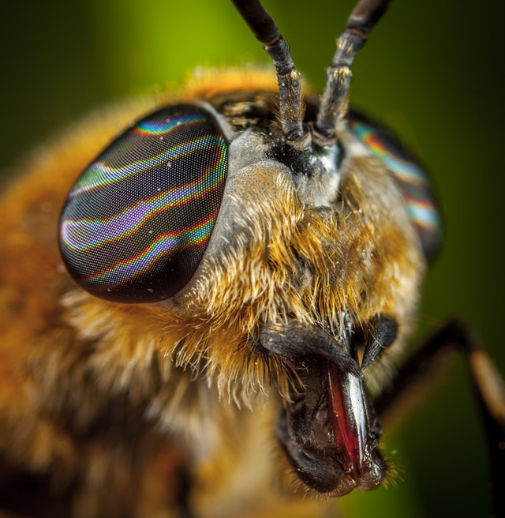
Here is the description of the strategy used by insects to increase their field of vision.
STEP 1 - note down key words and phrases which help understand how the strategy works
Insects have compound eyes. They consist of an array of small micro lenses, each with its own photoreceptor. The way they are arranged enables insects to have a large viewing field which helps them to detect motion over a wide field.

Slide 91
STEP 2 – highlight the key words you think are important in describing how an insect increases their field of vision
Insects have compound eyes. They consist of an array of small micro lenses, each with its own photoreceptor. The way they are arranged enables insects to have a large viewing field which helps them to detect motion over a wide field.

Slide 92
Is you selection similar to below?
Insects have compound eyes. They consist of an array of small micro lenses, each with its own photoreceptor. The way they are arranged enables insects to have a large viewing field which helps them to detect motion over a wide field.
Array
Large viewing field
Detect motion
These are all non-biological terms which can be applied into different situations.

Slide 93
You should have noted the following key words:
Array
Large viewing field
Detect motion
Now you need to combine your key words into a sentence describing the strategy in non-biological terms.

Slide 94
You might have written the following:
Arrange light receptors (cameras) in an array pattern to increase range of motion detection.

Slide 95
Add your data to the NatEnt platform
Add Natural Strategy and
Design Principle

Slide 96
Session 7
CREATE PHASE
Create Your Design Solution – part 1

Slide 97
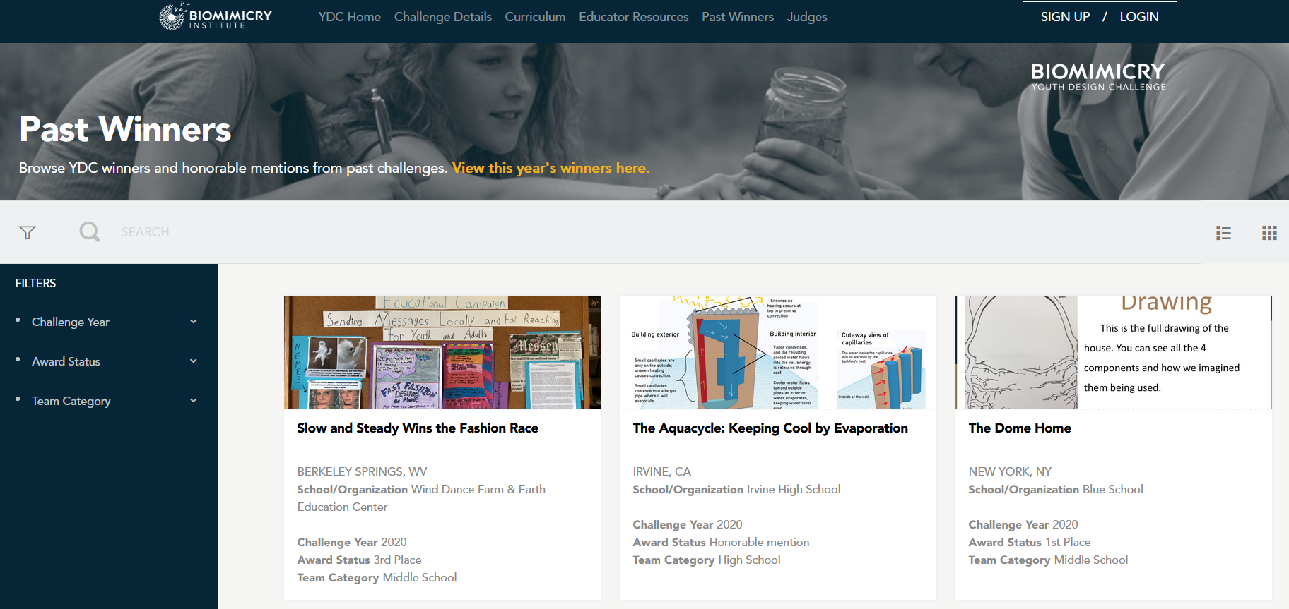
Finding Inspiration
Check out the Youth Design Challenge.
Select one solution you like and explain why.
https://youthchallenge.biomimicry.org/en/custom/ydcgallery/directory

Slide 98
Creating your Design Solution
You are now ready to start planning your Challenge solution using your nature inspired ideas.
Try the following:
Brainstorm some ideas on sheets of A3 paper.
Look at each other’s ideas, what is good, what is not so good.
Build on each other’s ideas. Mix up your ideas, try a bit of one nixed with a bit of another.
Start drawing/diagramming your Design Solution ideas.
What you think of first might not be the best…SO KEEP GOING!

Slide 99
Session 8
CREATE PHASE
Create Your Design Solution – part 2

Slide 100
Refining Your Design Solution
You have 3 minutes to talk to the Team next to yours about your ideas.
Then 3 minutes to swap over and listen to their ideas.
Identify at least 1 great idea the other Team has come up with.
Suggest at least one way they could improve their idea.
Listen to their comments on your idea and then go back to your planning and refine your idea again.

Slide 101
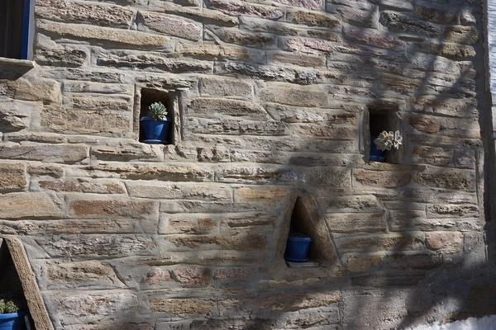
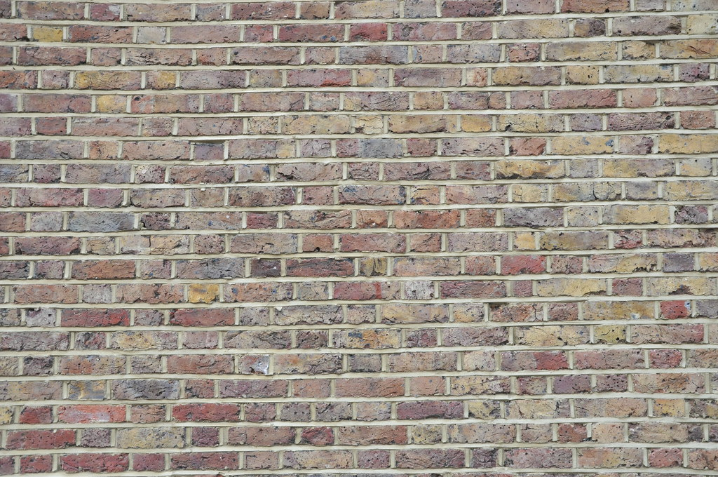
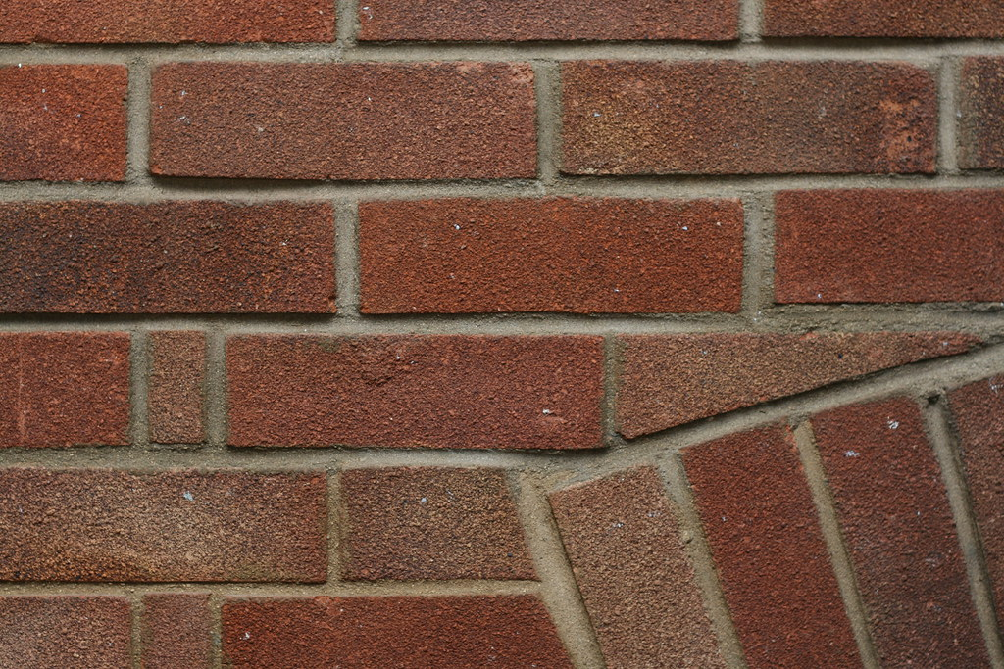
Design Solution - example
Challenge – how can we stop buildings over-heating on a hot day?
Why this challenge?
Context
Diverse housing stock (see images right) – some houses are up to 500 years old and built from a range of different building materials, and using various techniques. A one size fits all solution unlikely to work.
Initial thinking has considered how to prevent whole buildings from over-heating. Ideas from various organisms were considered including termites (passive ventilation), cacti (shading), dromedary camel (reduce conduction) and hornets/wasps (heat transfer).
After researching these organisms, it was decided to focus on a single intervention, namely reducing passive solar heat gain through external walls and roofs. This narrowed the direction of research and allowed for a more focused investigation into natural inspirations. As a result we reduced our detailed research from 6 natural models to 2 (see below).
Average temperatures have increased and are predicted to continue rising.
The following organisms where considered:
In…
Silver ants and Longhorn beetles – both display techniques for passive radiative cooling.
Out…
Termites – passive ventilation systems would require significant structural changes to existing budlings.
Cacti – shading is a good strategy but unrealistic in existing crowded housing estates; should be considered with new build.
Dromedary camel – mechanism of transferring heat to surface via sweat glands not applicable in present context.
Hornet/Wasp – possible use in new build houses but requires much more research.

Slide 102
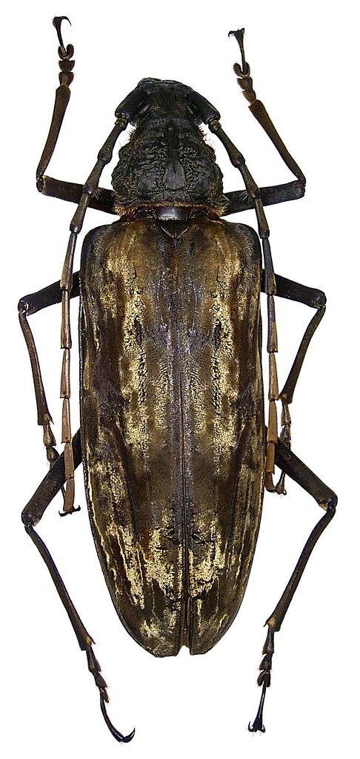
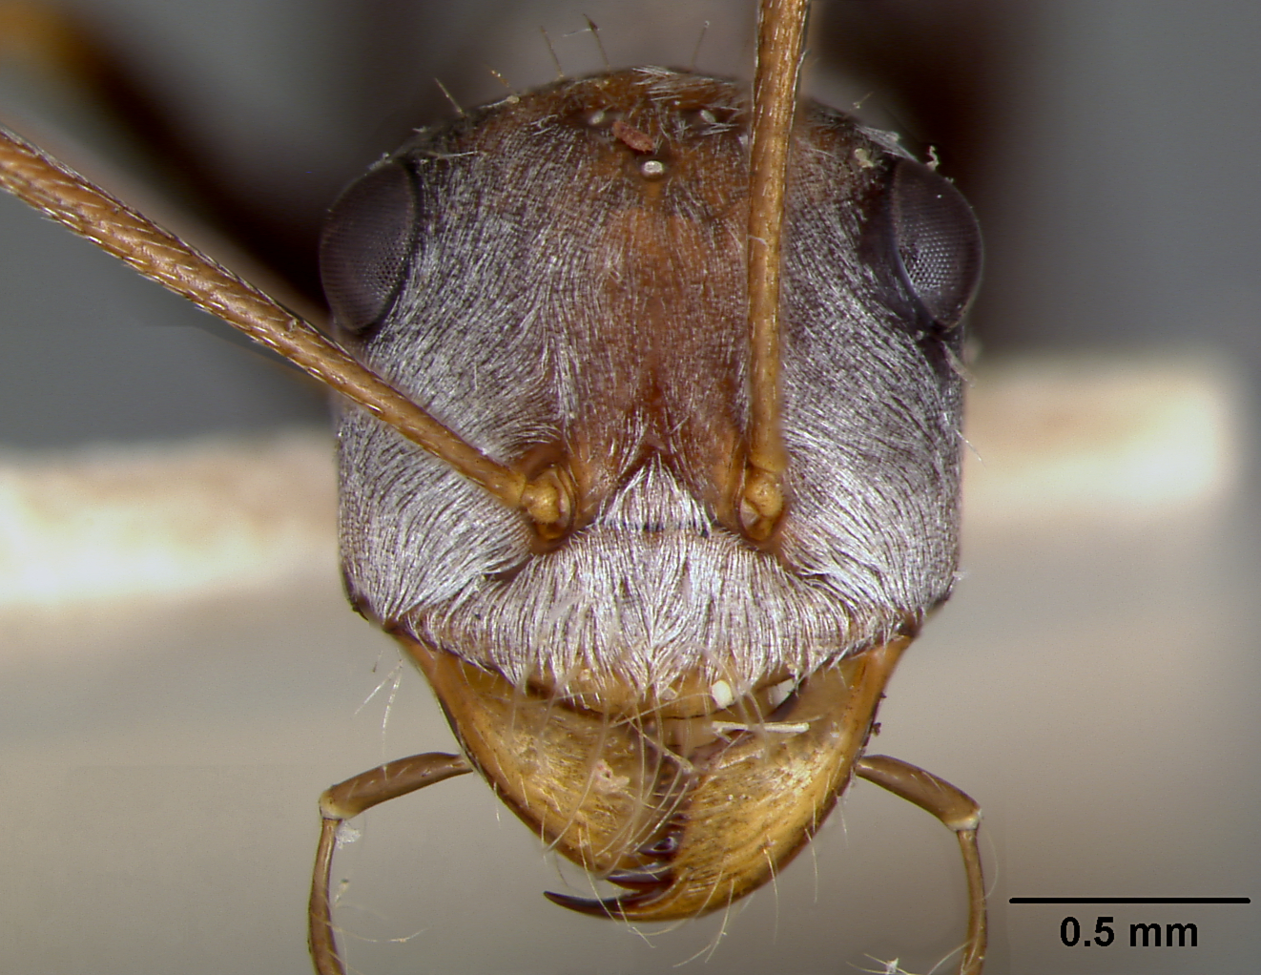
Research – what inspired?
"Cataglyphis bombycina soldier ant" by gailhampshire is marked with CC BY 2.0.
"Neocerambyx gigas (Thomson, 1878)" by urjsa is marked with CC BY-SA 2.0.
Both these insects live in extreme heat environments. They demonstrate ingenious adaptations to manage temperature and encourage passive radiative cooling.
Triangular fluffs (appear like tiny hairs) on forewings act to reflect light and increase heat emissivity.
Triangular aligned hairs on body act to reflect light and increase heat emissivity.
Saharan Silver Ant (Cataglyphis bombycine)
Longhorn Beetle (Neocerambyx gigas)
Chen, Xie, Wu, Mohamed, Elbashiry, & Lu (2015) Review of beetle forewing structures and their biomimetic applications in China: (I) On the structural colors and the vertical and horizontal cross-sectional structures in Materials Science and Engineering: C, Volume 55.
"Cataglyphis (Machaeromyrma) bombycina var. siniaitica" by W. Mann is marked with CC0 1.0.

Slide 103
How does it work?
These adaptations result in:
High reflectivity reducing heat absorption from vis-NIR.
High thermal emissivity of MIR which dissipates heat from the ant or beetle.
Because:
Pleats/corrugating results in high reflectivity and Mie scattering.
Triangular structure encourages high internal reflectivity.
Evidence:
Ant hair cover enhances emissivity by 15%.
Ant hairs reflect 67% of incoming solar radiation compared with 41% after their removal.
Beetle fluffs reflect 65% of incoming solar radiation compared with 30% after their removal.
Silver Ant hair cross-section
Both insects display a similar triangular pattern to their fluff or hair. Each also have one or two edges which are corrugated or pleated.
1
4
1. vis-NIR (near infrared) is reflected displaying Mie scattering.
2. MIR (mid-infrared) absorbed at higher incidence angle.
3. Increased emissivity of MIR at lower incidence angle.
4. MIR passes out.
2
3
1
4
3
3
4
References:
Zang, Ly, Liu & Fan (2020) Biologically inspired flexible photonic films for efficient passive radiative cooling in PNAS vol. 117.
Shi, Tsai, Camino, Bernard, Yu & Wehner (2015) Keeping Cool: Enhanced optical reflection and radiative heat dissipation in Saharan silver ants in Science vol. 349.
Schroeder, Houghtaling, Wilts & Mayer (2018) It’s Not a Bug, It’s a Feature: Functional Materials in Insects in Advanced Materials vol 30.
Longhorn Beetle fluff cross-section

Slide 104
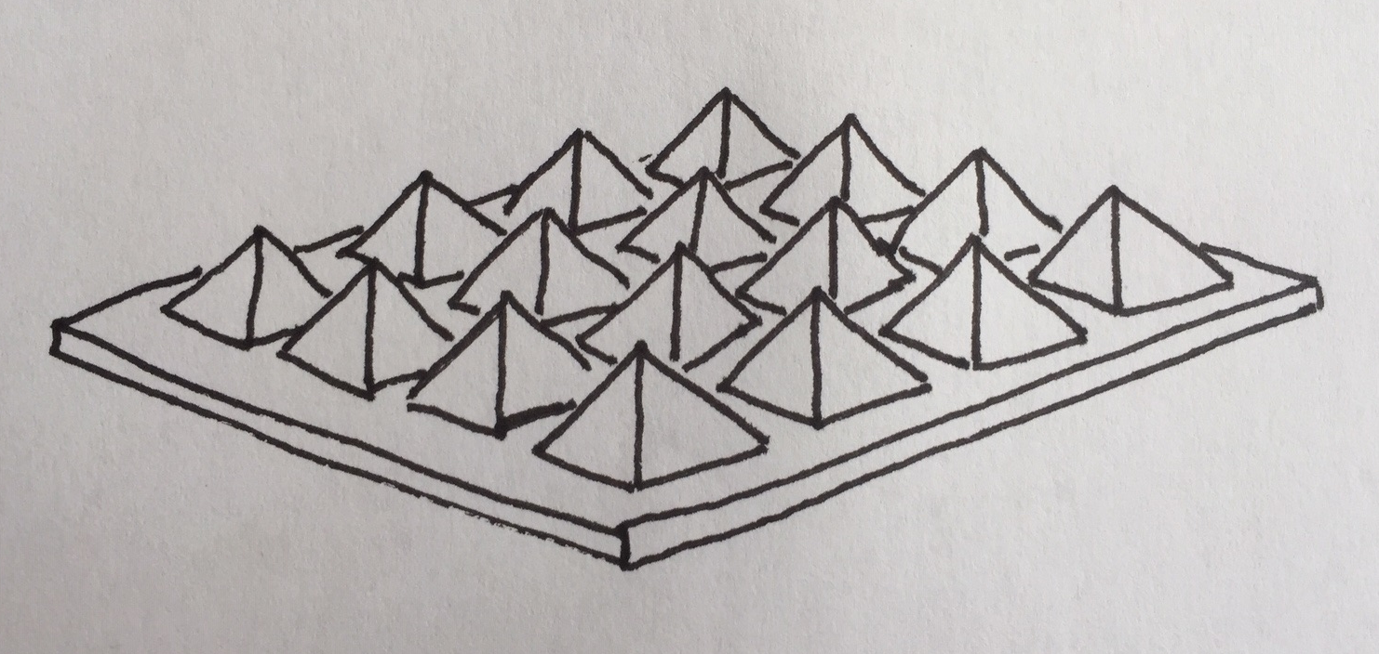
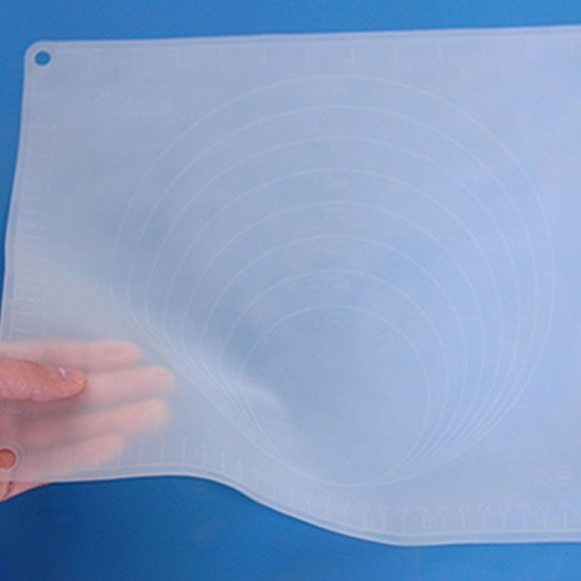
From nature to human application
Trials by Zhang et al* have tested the reflective and emissive properties of different PDMS (Polydimethylsiloxane) polymer shapes, namely pyramids, prisms and cones (the forms are micro-patterned onto PDMS sheets). Results show that pyramids (see image right) with a width of 8 μm and height of 5.7 μm performed best. With a 500 μm thick film, average reflectivity reached 95% as a normal incident angle. Average emissivity was >0.96 (or 96%).
Using PDMS polymer, it is possible to create a sheet material which could cover new or existing building facades.
PDMS is a synthetic polymer made from silicone and oxygen, and other elements such as carbon and hydrogen. It has low toxicity, can withstand high temperatures, is flexible and provides good insulation. For this reason it has gained popularity as an alternative to plastics. PDMS has a high potential for biodegradability, but more research is required. (See Is Silicone Biodegradable and is it Better than Plastic? from carboncompanion.com/is-silicone-biodegradable/).
This Photo by Unknown Author is licensed under CC BY
*Zang, Ly, Liu & Fan (2020) Biologically inspired flexible photonic films for efficient passive radiative cooling in PNAS vol. 117.
This Photo by Unknown Author is licensed under CC BY-NC

Slide 105
Creating your Design Solution
The best way to present your Design Solution is a drawing. Alternatively, you could build a prototype and record a video explaining how it works.
Your drawing should show how your solution will work. Annotate your drawing and provide some written explanations or guidance.
It can help to think about the following elements to include:
How have you addressed your Challenge and the Context?
Which Functions have your integrated into your design? (you can name and label them)
Which organisms inspired your design and how? (you can add a short description)
What external research have helped you? (provide a reference list)
Remember, that other Teams viewing your Design Solution will want to know how it works.

Slide 106
Share your Design Solution

Slide 107
Session 9
CREATE PHASE
Evaluating and Improving

Slide 108
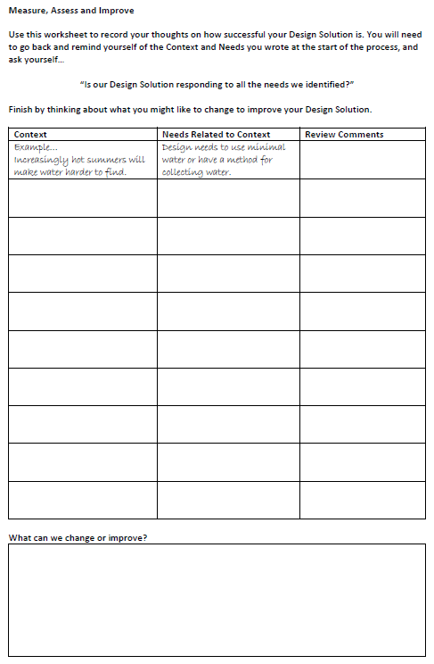
Evaluating and Improving
10 minutes
Read through the Context & Needs you identified at the start of the Biomimicry Design Process.
Think about which ones you have successfully addressed, and where you might need to make changes.
Complete the Context & Needs Review Sheet.

Slide 109
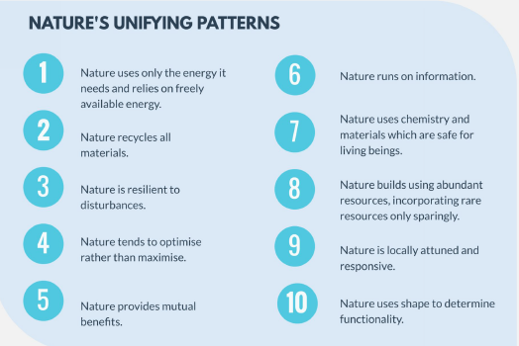
Evaluating and Improving
10 minutes
Read through the descriptions of Nature’s Unifying Patterns.
Select three which most relate to your Design Solution.
Complete the Design Solution Review Sheet.

Slide 110
Share your review

Slide 111
Session 10
COMMUNICATE PHASE
Communicating

Slide 112
Taking your Design Solution forward
10 minutes
You’ve created your first Design Solution…but what to do next?
More Research: maybe you have great ideas and your Design Solution looks good in theory, but you need to do more development work. In this case, you might want to pitch to a university or funding body to get more money to develop your product or service.
Bring to the Market: is your Design Solution something you are ready to produce and sell? Is it a product or service that meets a clear need? If yes, you might want to make a pitch to investors or a retail outlet that will sell your product.
Decide what you need to do next…

Slide 113
Creating a Pitch Deck
What is a Pitch Deck?
A pitch deck is a brief presentation that gives potential investors or clients an overview of your business plan, products, services and growth traction.

Slide 114
Creating a Pitch Deck
30 minutes
What should it include? Whoever you are pitching to, it is good to include
a slide for each of the following:
Title slide.
A summary that outlines your Team’s purpose.
Explain the problem your Team solves.
Compare your Design Solution with other ideas.
Milestones and accomplishments (what have you achieved so far)
Sell your Design Solution – why choose your Team?
Highlight the potential market for your Design Solution and how big the market might be.
Outline what you are asking for (financial investment, research grant, skills, etc).
Create your pitch deck…

Slide 115
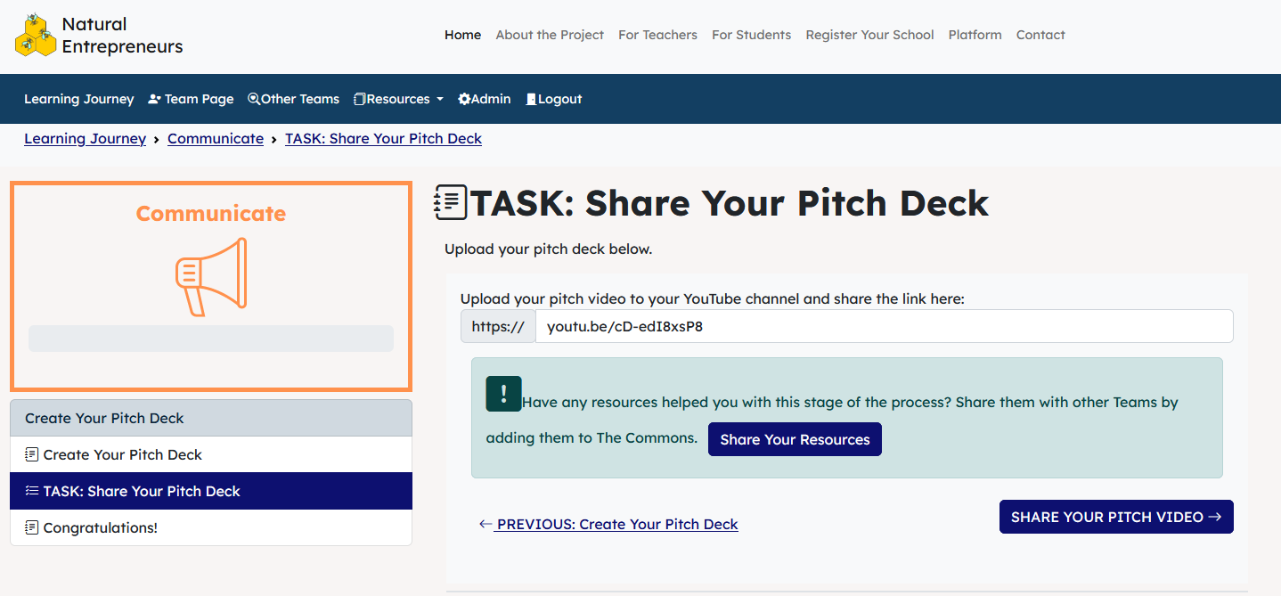
Share your Pitch Deck

